Slide 1
Loops and how antennas (aerials ) really work
By Professor Mike Underhill - G3LHZ

Slide 2
Summary 1
Small antennas are efficient
  The books are seriously wrong
  The ‘loop controversy’ is a serious misrepresentation of the facts. (It has been conducted in a very unscientific way.)
  ‘Heuristics’ shows why
But for small antennas that are efficient
  the bandwidth is small
  the antenna usually has to be tuned
  the Q is high
  transmit voltages are high
How can the Q be reduced without loss of efficiency?
  for more bandwidth
  for higher power before capacitor flashover (P∝1/Q²)

Slide 3
Summary 2
How do antennas radiate?
  Is it only the real current that radiates? – as the books demand
  Can capacitance also radiate?
  Do magnetic and electric displacement currents around the antenna also radiate?
  Do currents always radiate? How do you explain the Goubau single-wire transmission line?
  Once the RF has escaped the wire, surely it must just keep going?
  How are antenna patterns formed?
  Where in space are the patterns formed?
  What are the lines of power flow?

Slide 4
Summary 3
How do antennas receive radiation?
  Why is the antenna gain on receive the same as on transmit?
  Why is the capture area of a wire antenna so much larger than its physical area?
  What causes the RF to be focussed on to the wire?
  Why are small receive antennas only ‘effective’ below 85MHz?
How do you measure (small) antenna efficiency?
  Heat methods based on the First Law of Thermodynamics are reliable and trustworthy
  Based on: “What goes in must come out as RF or heat”.
  Field strength method are usually flawed and very inaccurate
  The identical pair of antennas is the solution to this
  It also measures ground loss under the antenna

Slide 5
Summary 4
The Loop Controversy is resolved:
  The loss under the antenna has been wrongly assigned to be antenna inefficiency
  The Chu- Wheeler small antenna Q criterion is shown to be flawed – by wrong initial assumptions
  We must repair the damage done to the reputation of small antennas for the good of the scientific and amateur communities
Can we use new better understanding of antennas to invent new small antennas?
  Or is it the new antennas that give the better understanding?
  Examples are tuned folded dipoles, hairpins, and twisted and coiled version of these
  Classically none of these can possibly work but they do!

Slide 6
Questions
For Antennas and Propagation, do we know it all already?
Or have we still something to learn?
Are Maxwell’s EM Equations the last word or are they just the beginning of something much more interesting, exciting, useful progressive and fit for the future?
What is new now and in the future?
Is progress possible or are we doomed to stagnation?

Slide 7
The Schopenhauer Effect
Joining the march of progress in science (and philosophy) has its dangers. New ‘truths’ and ‘paradigms’, such as ‘heuristics’, are rarely immediately accepted. (Heuristics is ‘hindsight theory’)
As the German philosopher Schopenhauer (1788–1860) put it:
“All truth passes through three stages:
  First it is ridiculed,
  Second it is violently opposed,
  Third it is accepted as being self-evident”.
Taken from “The Universe – a biography” by John Gribbin.
Something familiar here? – the loop controversy? – the CFA controversy? – the Goubau line controversy?

Slide 8
Heuristics – what is it? – 1
Heuristics is “hindsight theory based on observations and experimental measurements”.
It is learning from experience’. It is the process of ‘trial and error’ or ‘guess and confirm’. It leads to ‘discovery and invention’ It stimulates and educates ‘intuition’. It is the way to ‘do research’ in any field.
The word ‘Heuristics’ has the same root as the old Greek word ‘eureka’ – “I have found it”. Wikipedia says that the root for both is ‘heurisko’ (εὑρίσκω), which means “I find”.
Archimedes was using ‘heuristics’ when he realised he had a theory to explain the ‘observation’ that he was floating in his bath. For him the theory came from observation, not vice versa.
So ‘heuristics’ here means ‘deriving or deducing the theory from measurements and observations’. It is the scientific process!

Slide 9
Heuristics – what is it? – 2
‘Practical, real, not computer simulated, EXPERIMENTS are the first and only priority for heuristics – all else is subservient to this. The process is:-
EXPERIMENTS = observations, measurements, calibrations – leading to:
  Discovery and initial understanding from observation
  Extraction of all the ‘information’ in a set of measurements
DEDUCTION of consequences, leading to
HYPOTHESIS (unproven or uncalibrated theory)
  Initial Prediction of Performance Simulation. (For antennas: efficiency; input impedance; bandwidth; radiation modes; and mode patterns.)
VALIDATION and CALIBRATION Experiments to check the simulations and assumptions behind the theory to convert hypothesis to
HEURISTIC THEORY (Practically proven calibrated theory. Not ‘trust-me’ theory.)
  Deeper Understanding
  Models, Formulas, ‘Rules of Thumb’, Optimisation Strategies, and Design Rules
RESEARCH (look again):- new ideas, new designs, new aims and objectives
  And then back to EXPERIMENTS
Relying on theory or simulations, whether old or new, without experimental confirmation, is the road to self-delusion - Caveat emptor – buyer beware!

Slide 10
Heuristics – what is it? – 3
In summary, ‘Heuristics is The Paradigm of Experimental Science’
  It is theory and understanding from experiment and observations.
  It is the way to do research and to achieve understanding
For antennas and propagation:
  It is the way to explore propagation modes, old and new
  It is the way to invent new antennas
It is what radio amateurs do! –
  When a signal report is given or received
  When signal reports are compared in a regular net
  When a comparison A/B antenna test is made
  As an intrinsic part of any contest
  When antenna impedance Q or bandwidth is measured
  When antenna efficiency is measured
  When an antenna pattern, or front-to-back ratio, is measured

Slide 11
Contents of this talk on Small Loops
What is heuristics? – already done
‘The Schopenhauer Effect’ – a reaction to new antennas? – already done
Practical demonstration of ‘mag-loops’ – to make heuristic ‘observations’
The loop controversy – heuristics resolves it once and for all time! (No, it is not losses in the tuning capacitor – it does not get hot!)
How antennas actually work – starting with reception.
Small antennas are efficient. Heuristics demonstrates and proves this using the ‘First Law of Thermodynamics’ = conservation of energy and power.
Heuristic (ground wave) propagation measurements – reveals the main misunderstanding that has fuelled the ‘loop controversy’ – an olive branch?
Large multi-band horizontal loops – cannot be beaten?
Small multimode loops – for higher power and wider bandwidth
Some ‘impossible’ antennas – that are supposed not to work!
Talks for another time
The Goubau single-wire transmission line and its applications – the most important discovery in EM in the twentieth century!
The CFA, EH and other multi-mode small antennas – first hand practical experiences.
Ground sensing and wave-tilt measurements for HF propagation –some new discoveries
Better Antenna Simulation for the future? – a heuristic/experimental approach.

Slide 12
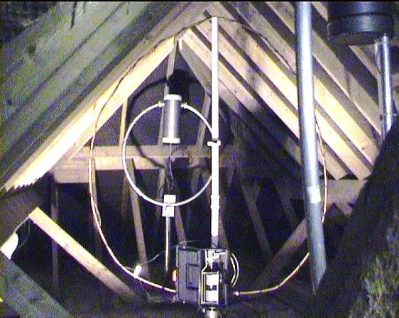
3 HF Transmitting loops in an attic ~λ/25 to λ/6 (in 2004)
A ‘small antenna’ is contained inside a sphere of radius λ/2π
In picture from furthest to nearest:
(a) AMA3 –
13 to 30MHz, diameter = 83cm
(b) Experimental double tuned 3.5 to 30MHz loop on rotator –
diameter = ~1.25m
(c) AMA5 –
3.4 to 11MHz, diameter = 1.7m

Slide 13
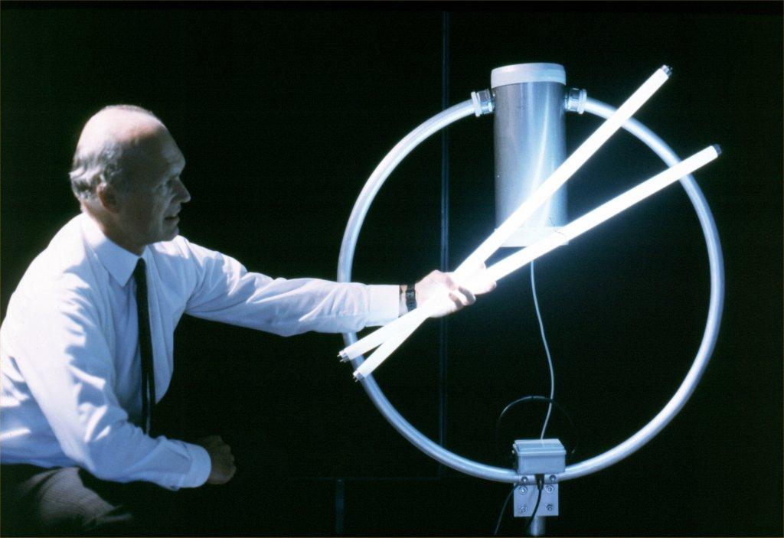
Where it started in 1994 – Public Demonstration at IEE and University of Surrey Inaugural Lecture

Slide 14
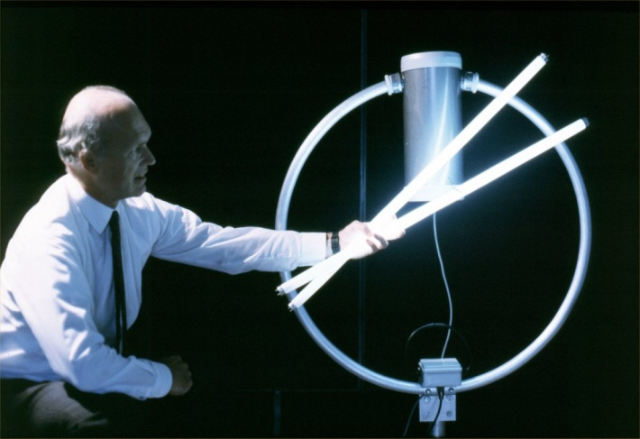
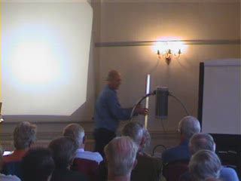
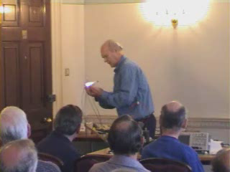
HFC2000 Demonstration of:
(a) Fields around a Loop
(b) ‘Cordless Welding’

Slide 15
Demonstration of AMA3 (from AA&A) – observations and conclusions
Loop description:
The AMA3 is a 83cm diameter loop of 3.2cm diameter aluminium tube. The original 15cm loop feed is not used. The ‘Twisted Gamma’ feed is used instead. It is more convenient and can ‘fine tune’ the matching. There is a motor tuned capacitor at top – about 50pF. It tunes 13 to 30 MHz with SWR < 1.5:1 over the band – depending on the loop environment. The loop is rated at 150 watts – it will handle about three or four times this after flashing off high points on vanes (or any insects)!
Observations are:
The rule of thumb for 10mm copper tube says Q < 250 = 56kHz bandwidth on 14MHz. The measured Q = ~172 with a 72kHz bandwidth. The bandwidth improves as cube root of tube diameter ratio?
For 100 watts input the loop is not warm to touch. Neither does the capacitor get hot. It can be compared with 100w bulb in a slightly larger tin, where the surface reaches 90 to 100°C. The loop is therefore 70 to 90% efficient.
Vertical fluorescent tube shows nulls along loop axis as expected for magnetic loop.
Horizontal fluorescent tube shows nulls along the loop plane, as for a horizontal (folded) dipole. Thus there is a strong folded dipole mode. It can be stronger than the loop mode.
As a consequence the loop is directional towards the capacitor.
A two turn insulated galvanised iron wire pick-up loop couples magnetically to give a ‘cordless welder’. The coupling is by magnetic displacement current through both loops?
If so, magnetic displacement radiates at right angles to the direction of the current. This is the same as the real conductor current in a wire.
We conclude that electric displacement current also radiates at right angles.

Slide 16
How Antennas Work

Slide 17
‘Reception’ is the key to how antennas work
It is more revealing to observe the process of reception first.
(Strangely, in the classical ‘books’ there is no direct explanation of reception. Reception is always by invoking the circuit principle of ‘reciprocity’. How many know the precise definition of circuit reciprocity?)
The receiving capture area of a wire (dipole) antenna is many times greater than the physical area of the antenna. Why?
There must be a ‘focussing lens’ surrounding the antenna. This must exist irrespective of the signal strength. What is the nature of this lens?
A property of the space immediately surrounding the antenna must have been modified. The near-field space must have been ‘warped’ by the presence of the antenna.
The space warp corresponds to a change in the ‘refractive index’ of the space surrounding the wire. This is what causes the energy focussing that occurs with wire antennas There is no other feasible explanation for the focussing of incoming received energy onto the wire.
This is the fundamental process of radiation reception by a wire antenna. It’s simple really!
What further observations and deductions can we make?

Slide 18
Radiation patterns of dipoles
Short Dipole ‘Doughnut’ Radiation Pattern
3D picture on right from Mathcad - ‘Any Dipole’ program

Slide 19
Antenna aperture and capture area
λ/2
Half-wave dipole
λ/4
Aperture = Capture Area
Half-wave dipole receiving aperture and capture area
Why is it so large?
Is it a focussing effect like a lens?

Slide 20
Antenna with two types of stored energy
Electric, Magnetic and Total Energy of a (Short) Dipole at UHF

Slide 21
Where does the radiation come from on the antenna?
Radiation per unit length of a half-wave dipole at about 5 to 10MHz.

Slide 22
Where does the radiation come from on the antenna?
Radiation per unit length of a half-wave dipole at about 1 to 2MHz.

Slide 23
The Goubau single wire transmission line

Slide 24
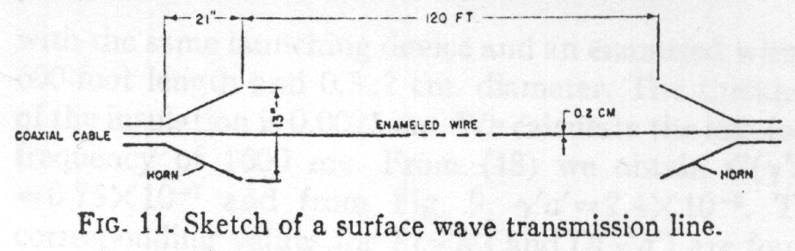
Goubau Single Wire Transmission Line
“Surface Waves and Their Application to Transmission Lines”, by Georg Goubau, J.A.P., Vol. 21, Nov., 1950, pp 1119 – 1128.
Enamel coat on wire 0.005cm ( = 50micron), ε_{r} = 3, tanδ = 8×10⁻³. 10 watts into this dielectric layer would burn it off! Dielectric layer is not needed?
At 3.3GHz, theoretical Sommerfeld surface wave line loss = 1.62dB, horns = 0.2dB each, so total theory = 2.0dB. Measured loss = 2.3dB, constant to ±0.1dB from 1.5 to 3.3GHz!
But loss from skin resistance of wire is = 1.7dB at 3.3GHz (assuming line impedance is 120π = 377ohms – probably nearer 300ohms). Thus line radiation loss is negligible.
But “Current” theory, “Method of Moments”, NEC etc. all say that the current, or more exactly the current squared on the line should radiate! If anything it should be the current, not current squared, that radiates.
No valid theory exists as yet for the Goubau Line. Perhaps it is ignored as an embarrassment by the experts?!

Slide 25
Importance of the Goubau Transmission Line
The current on a Goubau line does not radiate. Why? The basis of all current EM radiation theory, all EM simulators, NEC etc, is challenged.
Antennas radiate from ends, bends, feed-points and discontinuities.
Patterns of long-wires are frequency and wavelength dependent
Waves that carry power and do not radiate are called ‘evanescent waves’. Goubau line measurements and analysis provide a ‘heuristic’ theory of evanescent waves. This is the only valid theory so far.
Minimum Goubau horn size is proportional to the square root of wavelength.
Thus the Goubau line has a single evanescent wave layer below about 47.75 MHz. Above it has multiple layers.
Surface waves can have multiple layers.
Below the ‘Goubau Height’ any antenna sees suffers high ground losses.
Novel Goubau line antennas are useful at HF and VHF. UHF and above?
Goubau horn antennas have potentially interesting properties.
The Goubau Line is arguably the most important discovery in Electromagnetics in the Twentieth Century!

Slide 26
How antennas actually work – derived heuristically from observations and measurements
We observe that if the wire is tuned to resonance, or if it is of a self-resonant length, the received signal is increased. The capture area of the antenna is increased. There is a larger ‘focussing effect’.
Higher Q means more stored energy for a given signal power. It means a higher ‘energy capacity’
It is useful to define antenna ‘wave impedance 1/Q
What stores the energy when a signal arrives? Obviously it is the lowered wave impedance surrounding the antenna.
In essence that’s all there is to the reception/radiation theory of antennas!
So far we have said nothing about electric or magnetic fields!
We have only dealt with power and energy.
Neither have we mentioned Maxwell’s Equations!
Do we really need them?

Slide 27
New Antenna Theory

Slide 28
Summary ‘qualitative’ heuristic theory of electromagnetic radiation
Antenna surfaces create one or more (magnetic or electric) ‘energy storage modes’ surrounding the antenna. The modes are ‘distributed impedances’ in the space around the antenna. (The modes are present even when no power is being transmitted or received.)
Transmitted or received power P fills these modes with stored energy
U = PQ/2πf,
where Q is the total antenna Q and f is the frequency.
On receive, the stored energy creates the ‘capture area’ of the antenna. It focuses the received power onto the antenna surfaces, which convey it to the antenna terminals.
On transmit, the stored energy redirects the transmitted power to form the antenna pattern.
The stored energy matches the antenna to free space. (The match condition on receive is the same as on transmit.)
In (phased) arrays and Yagis, the power to-and-from each element is redirected by further ‘mutual energy’ stored in the ‘coupling impedance distribution’.
(“And that’s all there is to it!?”)

Slide 29
Qualitative heuristic theory – outcomes and validation
Consequences
Once the RF power is launched (1mm) from the surface of the antenna it does not return. The field/energy distribution surrounding the antenna re-directs power (by the generation of large displacement currents) to form the antenna pattern. It does not suppress the emission of the power in the first place.
Small transmit antennas are therefore fundamentally very efficient.
(The Chu-Wheeler criterion is seriously damaging. It needs urgent revision.)
There is a very wide range potential new designs for small antennas.
A small antenna needs sufficient stored energy to form its pattern. It therefore has a high Q and narrow bandwidth.
Stored energy can be partially cancelled to give lower Q. Lower Q antennas are more efficient and handle higher powers.
Validation
If the predictions of a theory are correct qualitatively, it is partially validated.
If the predictions of a theory are correct quantitatively, it is fully validated.
Calibration measurements (of antenna Q, input impedance, pattern, efficiency etc.) validate heuristic theory. The theory then predicts accurately.

Slide 30
Preliminary ‘quantitative’ heuristic theory of electromagnetic radiation – based on energy and power considerations
Observations and questions:
Sources create fields. But what field distributions are created?
Oscillating power sources can radiate power. But how much from a source of a given strength?
If sources can radiate they can also receive power. The ‘source’ is then a ‘sink’.
Each and every field stores energy. The total energy is U_{tot} =
Fields can convey power. What are the lines of power flow on transmit and on receive?
Definitions:
Q_{ant} is the antenna (source/sink) Q. For a total antenna stored energy E_{ant} and total radiated or received power P_{tot},, at angular frequency 2πf we have
Q_{ant} = U_{tot}/2πfP_{tot}
But what is the ‘local Q’ value Q_{loc} at any point in (near-field) space?
Q_{loc} = U_{d}/P_{d} λ
Note: in the far field Q_{loc} = 1 by definition.

Slide 31
‘Quantitative’ heuristic theory of electromagnetic radiation – based on energy and power considerations
Impact of Q:
Q_{ant} is the antenna (source/sink) Q. For a total antenna stored energy E_{ant} and total radiated or received power P_{tot},, at angular frequency 2πf we have
Q_{ant} = U_{tot}/2πfP_{tot}
The ‘local Q’ value Q_{loc} at any point in (near-field) space can be
Q_{loc} = U_{d}/P_{d} λ
  Note: in the far field Q_{loc} = 1 by definition.
The distribution of Q_{loc} appears not to scale with frequency
  This leads to a ‘quantum’ theory
  It means ‘radio-photons’ are not stable much below terahertz frequencies at room temperature
The group velocity of a wave can be said to be
v_{g} = c_{em}/Q_{loc}
A total group delay of Q_{ant}/f has to be added to the normal propagation delay.

Slide 32
Loop matching

Slide 33
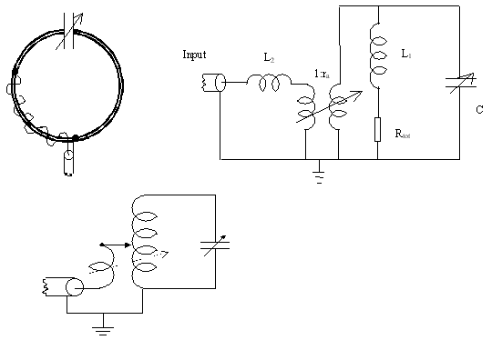
The G3LHZ ‘twisted gamma match’ for tuned loops, with equivalent circuits

Slide 34
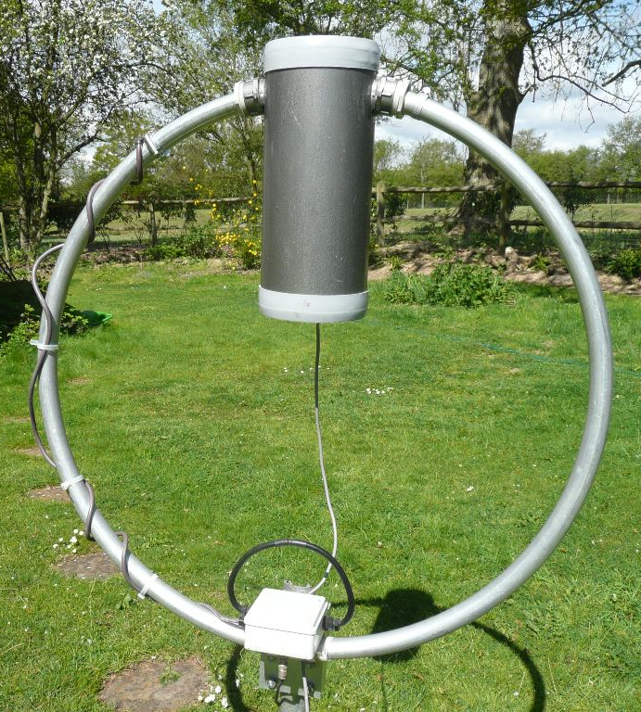
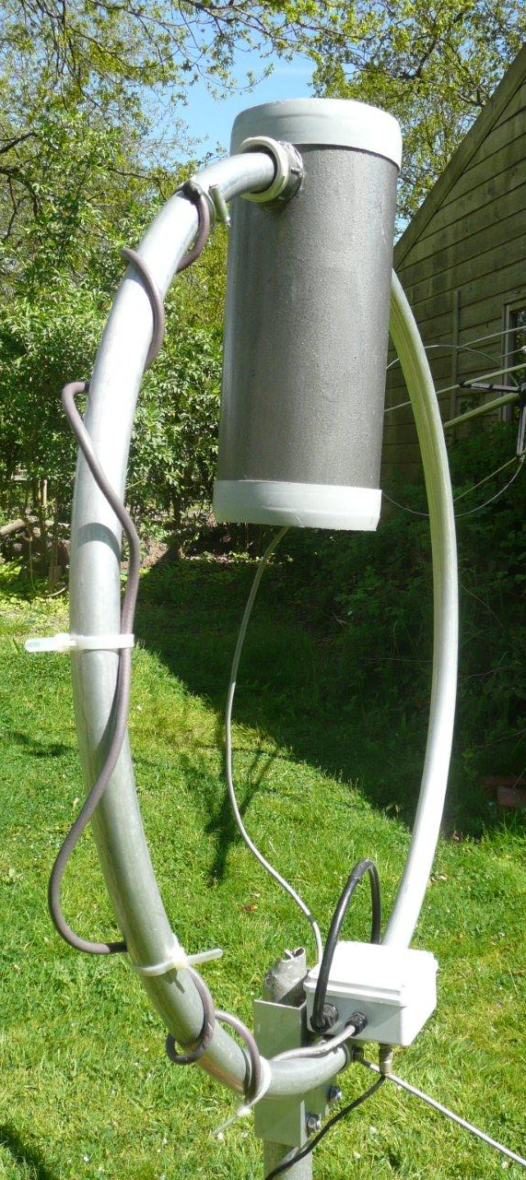
AMA5 Loop with double twist gamma match

Slide 35
The Twisted Gamma Match - 1
The “twisted gamma match” (or mu-gamma, or G3LHZ gamma match) consists of a long insulated wire wound loosely or tightly around the main loop starting from a chosen ground point.
It combines three coupling modes:-
  Inductive coupling - as by a small loop.
  Travelling wave coupling - as in directional couplers.
  Tapping along main loop - as in conventional gamma match.
The loop coupling is achieved by pulling out a small loop at a desired point along the gamma wire.
The travelling wave coupling is weak and it allows the point of maximum coupling to be moved to practically any point around the loop (for optimising directionality).
The best tapping point can be found using a large crocodile clip and then replacing this by a soldered joint, permanent clamp, or large “jubilee” clip.

Slide 36
The Twisted Gamma Match - 2
There are usually two essentially open-circuit points of practically zero coupling on the main loop, at approximately 90° and 270° away from the tuning capacitor. Practical coupling points can be found on either side of these “null” points.
An equivalent lumped circuit shows how the inductive coupling can cancel the tapping point voltage at certain places.

Slide 37
Wideband-Q method predicted SWR over tuning range of 1m loop:- < 1.5:1 from 3 to 18MHz

Slide 38
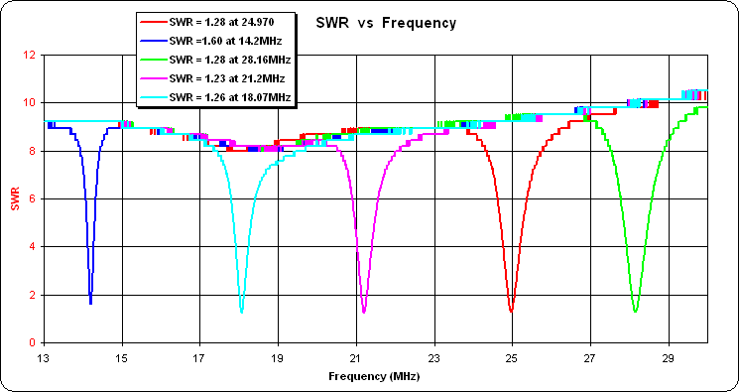
5 band < 2:1 SWR of AMA3 83cm diameter loop with ‘twisted gamma match’ – as seen on miniVNA

Slide 39
Loop efficiency

Slide 40
Summary of Antenna Efficiency – Using the First Law of Thermodynamics (conservation of energy law)
Antenna efficiency is
= (Power out)/(Power in) = 1 - (Heat in antenna)/(Power in)
This is the only true measure of antenna efficiency.
Most other methods, including the IEEE method, designate ground losses as antenna losses. Errors are then typically 5 to 15dB under the antenna and also under the field strength meter.
Inefficient small antennas can self-destruct with high power.
High power tuned loops do not self-destruct. They are efficient!
‘Heuristics’ proves (loop) efficiency experimentally in five+ ways:
  (a) the ‘heat balance’ method,
  (b) the ‘wide band Q’ method,
  (c) the simpler ‘rho-Q’ (loop) method
  (d) the ‘identical antenna pair’ (like-to-like) propagation/coupling method
  (e) the ‘A/B antenna comparison’ method

Slide 41
Tuned Loop Efficiency – The Controversy is ‘Classical Theory versus Practical Measurements’ (‘Wideband Q’ measurements)
Two turn 1m loop with 10mm copper tube:
  Measured Intrinsic Efficiency = Eff(k)
  >88% (-0.6dB)
  Measured Environmental Efficiency = Eff_{e}(k) >66% (-1.8dB)
  Traditional ‘classical’ prediction of Loop Efficiency = Eff_{trad}(k). At 1.8MHz = 0.08%
  or -31dB !!!!
Classical 1.8MHz = -31dB
Theory:- 3.6MHz = -19dB
14MHz = -3dB 5MHz = -13dB
28MHz = -<1dB 7MHz = -6dB

Slide 42
A case to be treated by Heuristics?:- “October 2007 Technical Topics – ‘Variable Dielectric Capacitors’ – for VFOs and Loops” 1
Brian Austin G0SGF draws attention to an article “Variable Dielectric Capacitors” by Harry Brash GM3RVL (Sprat, Issue Nr 131, Summer, 2007, pp10 to 12).
G0SGF comments: “I can see an immediate application for the technique as the tuning capacitor in an electrically small loop antenna – the so-called ‘magloop’.
“ As you may remember, in ‘TT’ (February, 2006, p73) Jack Belrose,VE2CV put his finger on the contact resistance of the rotor coupling mechanism as the reason why no one has ever managed to achieve, in practice, anything like the theoretical Q with these antennas, despite the claims in some quarters.”
Now as the ‘rather unscientific and scornful’ statement in italics addressed at (a) ‘the capacitor rotor coupling mechanism’ or (b) the undisputed fact that no one has ever managed to achieve, in practice, anywhere like the (classical) theoretical Q.
If it is not loss in the capacitor or in the antenna conductor material, then the inescapable conclusion is that the input power is nearly all being radiated.
This inevitable consequence and conclusion comes from the application of ‘Heuristics’ to the problem. (Heuristics is applied ‘common sense’ really!)

Slide 43
Oct 2007 TT – continued
“The Death of the Chu-Wheeler Small Antenna Criterion”
Can the scientific method of ‘heuristics’ prove whether capacitor loss is a true assertion or just ‘ignorant non-sense’?
  Heuristics uses basic Physics – in this case ‘The First Law of Thermodynamics’
  It says: “RF power out is RF power in minus heat generated in the antenna”
  If capacitor rotor losses are the reason why the ‘classical’ theoretical loop Q is not achieved, then the capacitor will dissipate practically all the input power. It will get hot!
Heat and power balance method to discover the ‘truth’
  (i) Measure with about 100 watts input to small (loop) antenna on 80m or 160m.
  We find typically there is well less than 10°C temperature rise, at any point.
  A 100 watt bulb in a 1.3 litre tin typically gives 80 to 90°C temperature rise
  (ii) Repeat with 400 watts. About four times the temperature rise will occur.
  Check whether the loop self-destructs!
Conclusion: efficiency is 80 to 90% or more
  Thus the classical (Chu-Wheeler) theoretical Q formula is pure ‘non-sense’. It 'ignores’ the much larger radiation resistance easily found by the application of ‘Heuristics’
  How can we repair the damage the damage that has been done in the past by this 60 year-old classical ‘dogma’? Difficult!
  Perhaps do the measurements and shout about them? But remember for some “the earth is flat, and that’s the final word – that’s that then”, as they say! Schopenhauer stage 2?

Slide 44
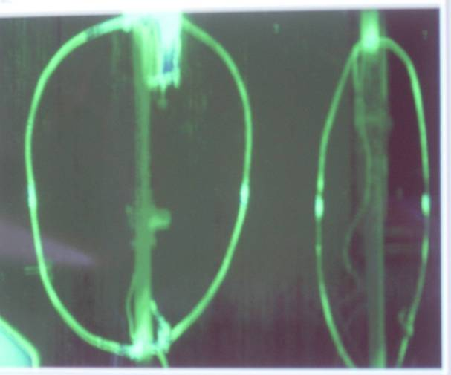
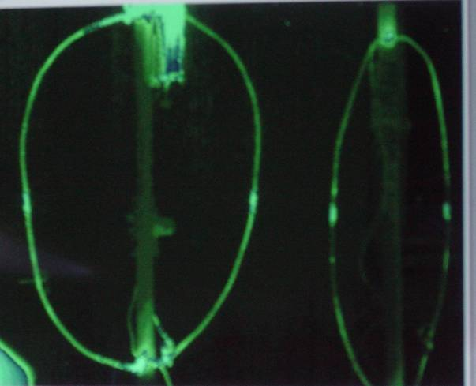
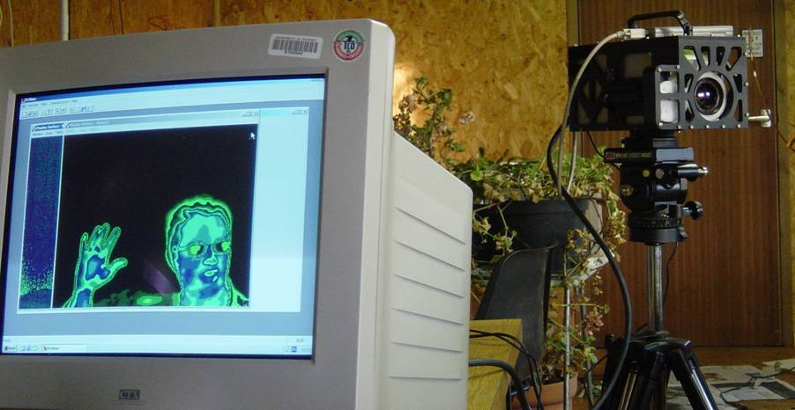
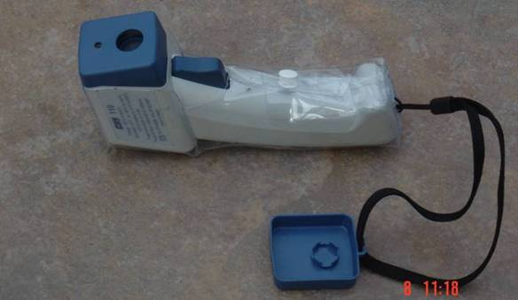
‘Heat Balance’ Measurement of Antenna Efficiency (as in Nov 2004 Radcom article on Loops)
The RF power lost as ‘heat’ is the same as the DC power the loop required to raise the same or an exactly similar loop to the same temperature.
The DC power heats a resistance wire inside the loop
Non-contact temperature measurement by Thermal Camera (below) or CHY 110 non-contact thermometer (bottom right).
Thermal picture is of Marc Harper.
Thermal emissivities of two loops are made equal by black paint patches at measuring points on the loops.

Slide 45
Thermal Camera Heat Balance Efficiency Results for 1m diameter Loop of 10mm Plumbing Copper Tube
Frequency in MHz | 1.98 | 3.7 | 7.03 | 10.12
Efficiency in % | 74 | 86 | 88 | 90

Slide 46
Some New Heat Measurements
The First Law of Thermodynamics says that the power lost in an inefficient antenna will be dissipated as heat. The antenna itself will get hot.
With high power to an inefficient loop “tuning for maximum smoke” can be too true!
If loop efficiencies really were the 0.1 to 10% that the critics claim, practically all the RF input power would be dissipated in the loop (or loop capacitor) as heat.
150watts DC (14.0 V and 10.7A) into resistance wire in a 1m diameter loop of 10mm tube (in October 2004 RadCom) gave a temperature rise to 100°C. Ambient temperature was 14.0°C
The temperature rise was 86°C (±1°C). The temperature rise is proportional to heat power lost for both radiation and convection.
Therefore for 400 RF watts supplied and 396 watts dissipated in a 1% efficient loop, the loop temperature would be rise to 241°C and more for any joints and connecting wires.

Slide 47
Some New Heat Measurements (continued)
Tin-lead solder melts at about 180°C. PVC melts at 180°C. Nylon washers melts at 220°C. PTFE melts at 327°C. Combustion of paper starts at “Fahrenheit 451”or 233°C. Copper melts at 1085°C.
Thus a 1% efficient 1m loop would self-destruct from self-heating with 400 watts input!
An ‘HF’ (10 to 30MHz) loop has typically has the same surface area of copper as above.
A minimum practical MF loop(1.8 to 10MHz) has about 2.5 times this copper surface area, so about a kilowatt dissipated would be needed to achieve these temperatures.
150 watts input dissipated in my ‘twisted gamma’ wire its temperature would rise to 1095°C. The PVC insulation would melt and catch fire and then the copper wire would melt.
I think the importance of loop efficiency for high power operation should now be obvious!

Slide 48
How to measure Antenna Q
At the frequency of interest f₀ match the antenna to 50 ohms to give 1:1 SWR (on Antenna Analyser)
Detune (the analyser) to lower frequency f₁ where the SWR is 2.62.
Detune to higher frequency f₂ where the SWR is 2.62.
The antenna Q is then: Q = f₀ /(f₂ - f₁)
Why SWR= 2.62?
Half-power or -3dB points occur when the reactance of tuned circuit becomes equal to ± j50 ohms, where j =√(-1).
Reflection coefficient ρ = {1-(1 ± j)}/{(1+(1 ± j)}.
Modulus of the reflection coefficient = | ρ |= 1/ √(2² +1) = 1/√5
SWR = (1+|ρ|) / (1+|ρ|) = (1+ 1/√5)/(1 - 1/√5) = 2.6180

Slide 49
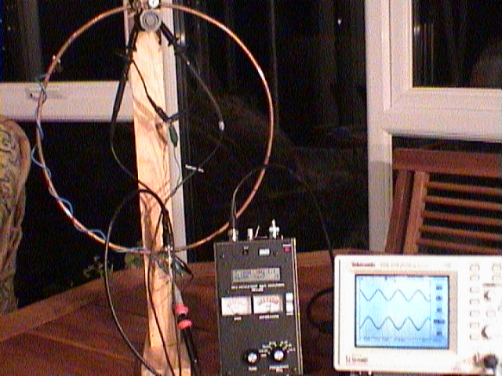
Loop capacitor voltage relative to 50 ohm matched input voltage on Tektronix TDS 210 scope using MFJ269 antenna analyser as a matched source

Slide 50
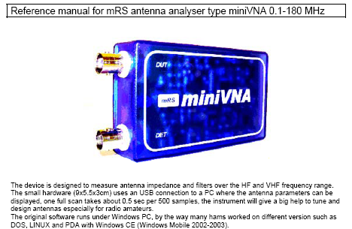
miniVNA Vector Network Analyser

Slide 51
miniVNA – ‘DET’ connection makes it a two-port VNA for ‘transmission’ measurements

Slide 52
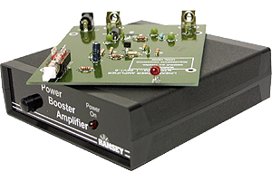
LPA-1C Ramsey Linear Power Amplifier Kit: * Frequency: 100kHz - 1GHz , * Output: 1W, * Supply: 12 - 15V DC @ 250mA
Gain of 25 – 30dB extends transmission range by > 10 times

Slide 53
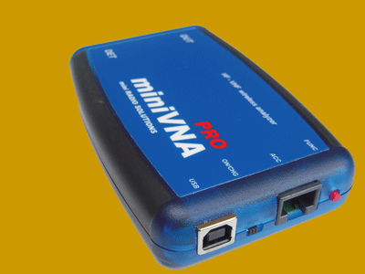
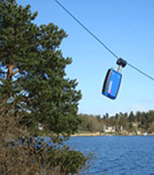
miniVNA pro Vector Network Analyser
The new miniVNA PRO, the big brother of the well-known miniVNA, is an extraordinary and unique handheld vector network analyzer that makes available a multitude of new features and capabilities which are perfect for checking antennas and RF circuits for hams and commercial users. Together with your PC/Laptop, you can add to your laboratory the further advantages of having this first-class VNA instrument.
This is the world’s first wireless analyzer capable of scanning and sending the data using an integrated Bluetooth module to a remote PC/Notebook up to 100 meters from the miniVNA PRO’s location. This makes real-time antenna setup easy!

Slide 54
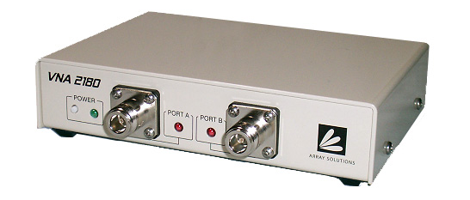
Array Solutions
Vector Network Analyser VNA 2180
Main Features
Port A is equivalent to an antenna analyzer (Similar to the AIM4170C). Port B has a 50 ohm input impedance with return loss greater than 30dB. Port B Nominal Dynamic Range: 100dB up to 50MHz, 85dB up to 180MHz. Programmable RF amplitude for Port A (+7 to –19 dBm). Resistance and reactance measurements of antennas and discrete components. Impedance measurements through filters or networks. Markers for impedance scans and Smith charts. Parameters that can be plotted include: Resistance and reactance for series or parallel equivalent circuits, SWR or reflection coefficient (S11), Return loss, Phase angle with sign, Two port network transmission (S21), Cable length, impedance, loss, and velocity factor, Distance to fault (open or short). Smith chart displays (featuring phase rotation and zoom). Band scan to check for interfering signals. Quartz crystal parameter measurements. Pre-programmed functions, such as tuning a ¼ WL stub, and many more. Calibration loads are included. No internal adjustments. Optically isolated USB interface to PC.

Slide 55
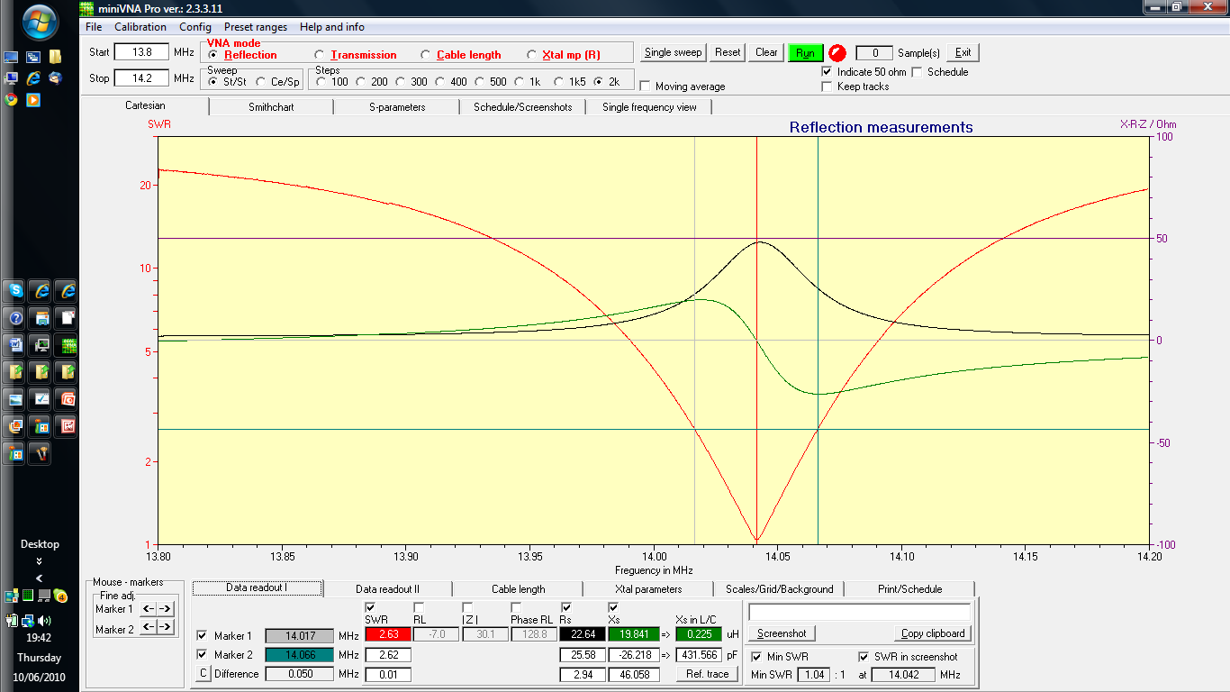
MiniVNA pro plot of AMA3 – as used for the ‘fluorescent’ tube demo. Q = 281

Slide 56
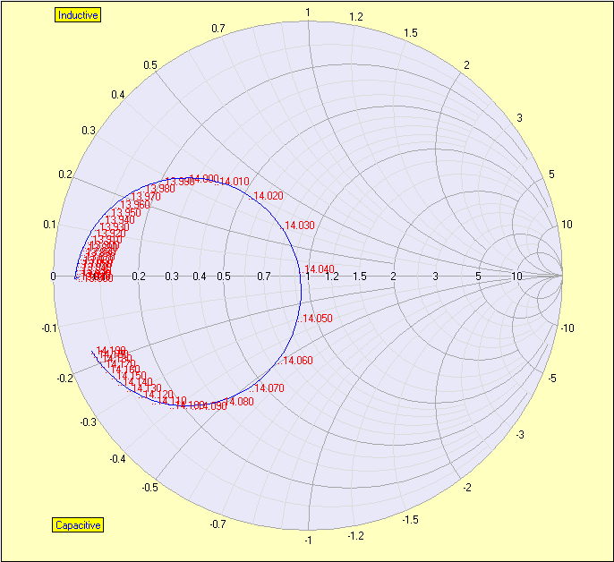
MiniVNA Pro:- Smith Chart plot of AMA3

Slide 57
Simple Rho-Q Method for Antenna Efficiency -1
It is a simplified form of the heuristic Wideband-Q method (shown later)
Given the measured Q of a loop, its efficiency is easily found from its dimensions and the loop conductor resistivity ρ (rho).
The efficiency is
η =Rrad/Rtot = 1 - Rloss/Rtot = (1 - Q Rloss/Xl) (1)
In the above we have used reactance Xl = 2πfL and Rtot=Xl/Q=2πfL/Q
The conductor loss Rloss is the “skin effect” loss of the loop conductor.
This can be found from the DC resistivity ρ of the loop conductor material, the conductor length, the loop circumference Cir, and the conductor tube or wire effective diameter d.
The skin effect loss resistance Rloss is proportional to the square root of the frequency and the square root of the DC resistivity ρ of the loop conductor
The skin effect loss resistance for the loop is found to be
Rloss = √(0.4× fMHz× ρ)×Cir/d (2)

Slide 58
Simple Rho-Q Method for Antenna Efficiency-2
For (phosphorous de-oxygenated) plumbing copper the DC conductivity is on average 85% that of pure copper. Its DC resistivity is therefore
ρ = 1.72×10⁻⁸/(0.85) = 2.0×10⁻⁸ ohm metres. (3)
The Rloss for plumbing copper in ohms for frequency in MHz is then
Rloss(Cu) = 8.94×10⁻⁵√(fMHz)×Cir/d (4)
For typical aluminium the DC loss resistivity is 2.5 times higher than plumbing copper and its skin effect resistance is √2.5 = 1.58 times higher. For Q = 300 the loss for aluminium tube can be given as
Rloss(Al) = 1.41×10⁻⁴√(fMHz)×Cir/d (5)
These values are then use in the above efficiency formula. The following spreadsheet has been created to facilitate this:

Slide 59
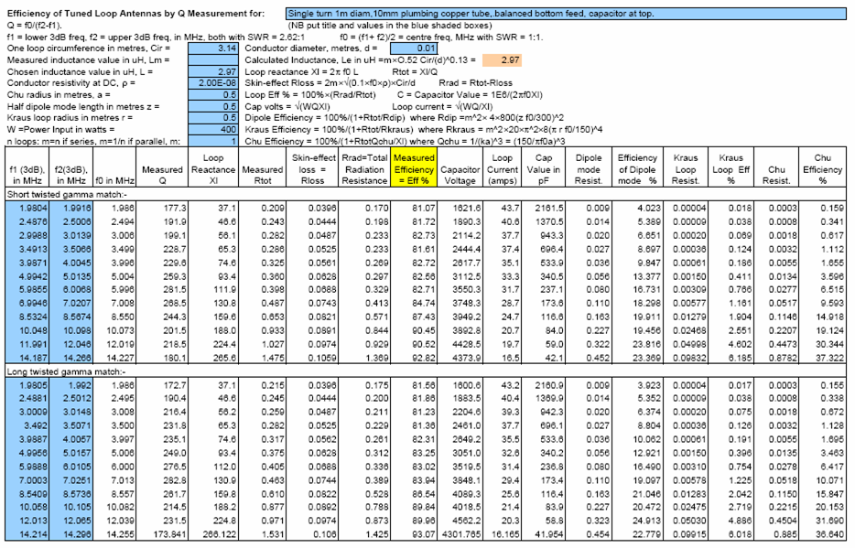
Rho-Q Loop Efficiency Spreadsheet

Slide 60
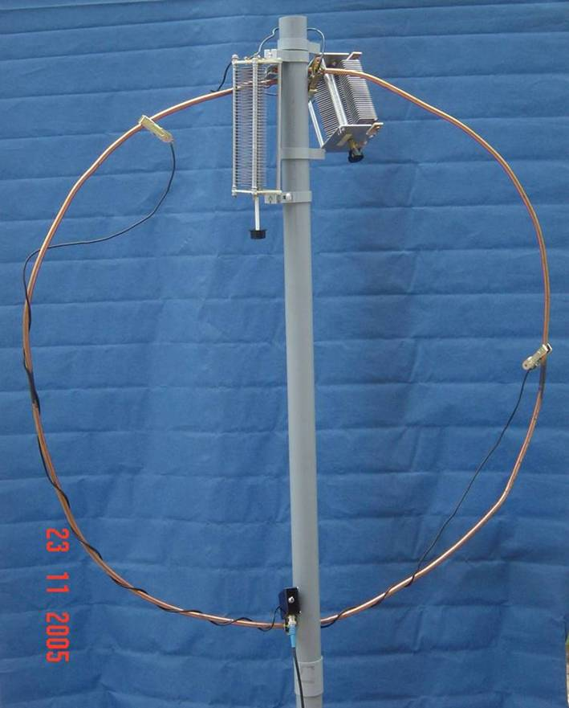
Rho-Q Loop Efficiency Spreadsheet
The spreadsheet automates the Rho-Q method.
Loop dimensions are inserted in blue shaded boxes at top.
The pairs of 3dB frequencies that are the Q measurements are put in the two blue shaded columns at the left.
Un-shaded columns are calculated outputs.
The formulas for these outputs are given in the top rows.
The measurements shown are for the experimental 1m diameter loop of 10mm copper plumbing tube shown left.
It has two twisted gamma matches of different lengths, switched at the bottom.
There is no significant difference in efficiency η for a short twisted gamma feed (top measurements) or a long twisted gamma (bottom measurements).
Other feeds also give the same efficiency.
The measured loop efficiency is compared with the classical predictions. Note the large discrepancies!
Included are (a) Tuning capacitance values (b) Capacitor voltage for given power input, and (c) loop current.
Qmode is the estimated Q for a conducting material with zero resistivity. Qmode = Qmeas/η)

Slide 61
Rho-Q Loop Efficiency Spreadsheet - 2

Slide 62
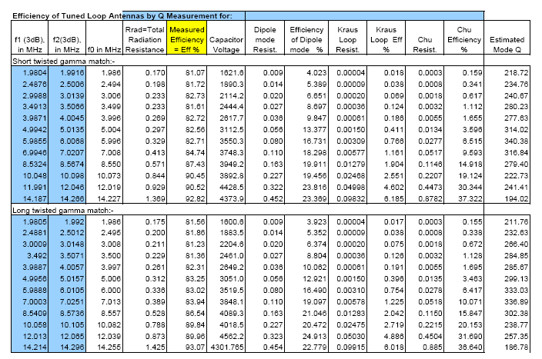
Rho-Q Loop Efficiency Spreadsheet - 3

Slide 63
The importance of the simple Rho-Q Method for Antenna Efficiency
Each Q measurement immediately provides an efficiency answer at each measurement frequency
No formula for radiation resistance has to be assumed.
No ground losses need be taken into account.
No ground wave propagation formula is needed.
The (loop) antenna pattern above ground is not needed.
No field sensors have to be calibrated (at the point of use).
The DC resistivity values of loop conductor materials are well established.
It shows that a copper loop of 10mm diameter (or aluminum tube of 17mm) will be 80% to 90% efficient, whatever its length! Much larger is a waste of copper (or aluminium).

Slide 64
Wideband-Q ‘ Heuristic’ Method for Measuring All Radiation Resistance and Loss Components
Relies on measuring Q over as wide a tuning range as possible and fitting these measurements heuristically to a simple equivalent circuit model.
Components can be separated because each varies differently with frequency and, or antenna size.
The value of the model parameters for each component are chosen to give the best fit of model and experiment. Accurate if Q > ~15.
Inductance of loop or capacitance of dipole/monopole was originally assumed constant with frequency up to antenna self resonance.
  The latest (miniVNA) measurements indicate that loop inductance increases weakly with frequency. An approximately f^{1/2} law has been measured over a frequency decade. Thus loop Q appears to increase with frequency as f^{1/2.}
Total combined series resistance is then given as reactance/Q = X_{L}/Q or X_{c}/Q.
For the best fit to measurements we find (unexpectedly) that the resistances are “uncorrelated” and have to be combined by a “root mean square” (RMS) operation.
  The explanation is that all resistance components are distributed and are not directly coupled to each other.

Slide 65
Loop Radiation Resistance Components
The Wideband Q ‘Method is a ‘Heuristic’ Method that extracts and separates from one set of more than n+1 measurements the following n radiation and loss resistance components:-
1. Traditional loop radiation resistance:-
R_{trad} = 31,171 (A/λ²)² = 20π⁶ (D/λ)⁴ = 19,228(D/λ)⁴
  Only becomes appreciable near loop self resonance at f_{res}(MHz) ≈ 22/D.
  Can be enhanced near ground or with connected or unconnected ground plane.
2. Newly discovered loop radiation resistance – the Retarded Biot-Savart Mode
  R_{loop} = X_{L}/Q = X_{L}D/500.
  where X_{L}= 2πfL, L ≅ 1μH ×π D in practice, and Q ~ 500/D(metres)
  This is affected by presence of the ground image and ground resistance; it can be halved (and the Q doubled) in the extreme case.
3. Dipole mode radiation resistance.
R_{dip} ≅ (π/2)²×20 (ka)² = (π/2)²×20 (πD/λ)² = 487×(D/λ)²
  Can also be enhanced by presence of ground or ground planes.

Slide 66
Loop Loss Resistance Components – continuation.
4. Conductor losses for copper tube
R_{loss} = 7.07 × 10 ⁻⁶ × π (D_{loop} /D_{tube}) (f_{MHz})^{0.5}
  – Conductor loss resistance. Has a square root of frequency law because of “skin effect”.
6. Conductor losses in nearby walls etc. Also has f^{1/2} characteristic. Varies depending on distance from walls.
Losses from ground conductivity σ and dielectric ε. These have a cut-off frequency f_{c} when σ = 2πfε. f_{c} ~ 1-30MHz
– novel observation?
Ground (re-)radiation resistance. This is not ground reflection. It is radiation from the induced ground currents as if the ground were a patch antenna. It is most marked for highly conductive ground.
– novel observation?

Slide 67
Tuned Loop Mathcad Worksheet Circuit Model – a simulation!
Features:
Tuned Plots e.g. Smith Chart & SWR.
Envelope Plots e.g. SWR Envelope.
Smith Chart Plot – 10K points.
Choose tuning capacitor – plot match over frequency.
Choose k_{m} Coupling(s) = 1/R_{a} = adjust gamma match.
Choose input (gamma) inductance(s) (for SWR).
Efficiencies.
Capacitor Voltage and loop current.
Actual Voltage Ratio (0.02 watts input).
Q curves
Operating Bandwidth.
Compare with measurements to separate all resistance components

Slide 68
MJU Mathcad Loop Worksheet - 1

Slide 69
Fig 2. Comparison of measured and predicted input impedance at centre of loop tuning range 10.21MHz

Slide 70
Comparison of measured Q values with model predictions over the loop tuning range. Upper with RSS power combining of radiation and loss resistances. Lower with resistances added conventionally.

Slide 71
68cm loop over wet field
MJU Mathcad Loop Worksheet - 2

Slide 72
MJU Mathcad Loop Worksheet - 3
Radiation Modes and Loss Resistances:
Folded Dipole Mode
New Loop Mode
Conductor Loss Resistance
Traditional (Kraus) Loop Mode
Detected Skin effect Environmental Loss
Ground Loss including cut-off frequency

Slide 73
The Chu-Wheeler Criterion for Small Antenna Q
The original Chu-Wheeler criterion states that
Q_{min}(original) = (ka) ⁻³
where a is the radius of the sphere just containing the small antenna and
k = 2π/λ (the propagation constant).
  This criterion has been used to ‘rubbish and condemn’ many small antennas and to ‘prove’ that their inventors are ‘charlatans’
From many plots of separate mode radiation and loss resistances (as in previous slide) we find an approximation for the real Chu-Wheeler criterion should be
  for a one metre loop :
  Q_{min} (reality) = [{300/(ka)}² + (ka)⁶ ] ^{0.5}
  this loop is typically 80% to 90% efficient.
  For a 35cm loop
  Q_{min} (reality) = [{120}²/ka + (ka)⁶ ] ^{0.5}

Slide 74
Loop Design Formulas - Inductance
The loop inductance defines the required capacitor values for the required tuning range.
The loop diameter is D in metres. The wire/tubing diameter is d. C = loop circumference, and area = A. λ = wavelength.
Traditional formula due to Patterson (of Patterson loop fame?)
  L(μH) = 0.00508A × [2.303 log (4A/d) – 2.451]
  This is not accurate for thin wires.
A more complicated formula from Grover is more accurate.
New empirical formula ( - good for small loops):
  L(μH) = C(1.25D)^{1.6}/(160d)^{1/6}
  This is to be fine tuned when more measurements are available.
But beware, all is not what it seems when ‘real’ measurements are made – with an analyser, the miniVNA. See next slide:

Slide 75
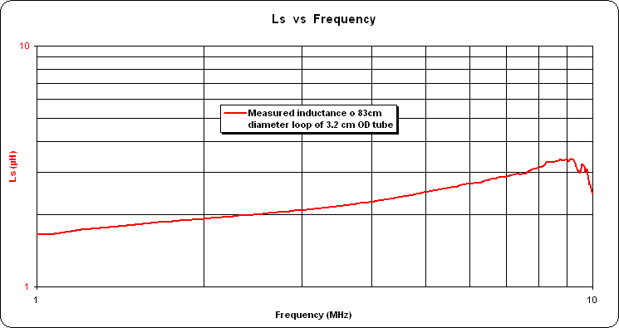
Inductance of single turn loop appears to vary with frequency!

Slide 76
2 Turn Loop in Conservatory

Slide 77
Using Heuristics to resolve the ‘Loop Controversy’ once and for all time!
Method
Four ‘Heat Accounting’ (heuristic) measurement methods based on the ‘First Law of Thermodynamics’ show that the small tuned loop of 10mm (or more) diameter copper tube is always 80% to 90% efficient
The existing ‘Chu-Wheeler Small Antenna Criterion’ is firmly contradicted. It is in urgent need of revision to prevent it being used to do any more damage to small antenna design and invention .
The 15 to 30dB discrepancy when efficiency measurements are made over ‘real ground’ needs further measurements and a ‘heuristic’ theory and explanation.
The loop critics have mistakenly included ground losses immediately under the loop and field sensor in their loop efficiency estimates.
Note that the only ‘safe’ way of doing field strength measurements over ground, is between an identical pair of antennas. The ground loss under both antennas is then easy to measure. The field at the half-way point can be calculated exactly and then used to calibrate any field sensor for further use.

Slide 78
Tuned Loop Efficiency – The Controversy is ‘Classical Theory versus Practical Measurements’ (‘Wideband Q’ measurements)
Two turn 1m loop with 10mm copper tube:
  Measured Intrinsic Efficiency = Eff(k)
  >88% (-0.6dB)
  Measured Environmental Efficiency = Eff_{e}(k) >66% (-1.8dB)
  Traditional ‘classical’ prediction of Loop Efficiency = Eff_{trad}(k). At 1.8MHz = 0.08%
  or -31dB !!!!
Classical 1.8MHz = -31dB
Theory:- 3.6MHz = -19dB
14MHz = -3dB 5MHz = -13dB
28MHz = -<1dB 7MHz = -6dB

Slide 79
DEFINITIONS OF ANTENNA EFFICIENCY AND EFFECTIVENESS
“Where does the power go?”
15 efficiency definitions = Pn/Pm
P6 is power density in a given direction
P6/P5 is the ‘directivity’ in that direction
Important ratios are: ‘intrinsic efficiency = P3/P2’, ‘total antenna efficiency = P5/P2’ and ‘antenna gain = P6/P2.
‘Intrinsic efficiency’ is important because it is little affected by the environment and is essentially the efficiency of the antenna in free space.
It is the proportion of the input rf that just escapes the surface of the antenna and has not been dissipated as heat in the antenna conductor surfaces.
Effectiveness = (Antenna gain from transmitter) /( Cost etc). It is qualitative!
We need agreed standard definitions validated by measurements. For many years there has been much confusion and misunderstanding. The IEEE-Std 145-1993 on antenna efficiency has not helped!
P3, Antenna radiation &
P2, Power into
P3, Antenna radiation &
P2, Power into
P1, Power from
P1, Power from
Intrinsic Efficiency =
antenna & AMU
Intrinsic Efficiency =
antenna & AMU
transmitter
transmitter
P3/P2
Efficiency = P2/P1
P3/P2
Efficiency = P2/P1
Antenna
Antenna
‘
Seen’ loss
‘Seen’
Environmental
Losses
Matching
Matching
Antenna
Antenna
and radiation
Unit
Unit
resistances
P4, Near
P4, Near
-
-
field radiation &
field radiation &
Environmental Efficiency =
Environmental Efficiency =
P4/P2
P4/P2
Antenna
‘
Antenna
‘
Unseen’
Unseen’
P6 =
P6 =
erp
erp
to
Radiation
to
Environmental
Radiation
Environmental
Propagation Path
Pattern
Propagation Path
Losses
Pattern
Losses
& Antenna Gain =
& Antenna Gain =
P6/P2
P6/P2
P5, Total Antenna Radiation &
P5, Total Antenna Radiation &
Total Antenna Efficiency =
Total Antenna Efficiency =
P5/P2
P5/P2
Figure: Various losses and antenna efficiencies

Slide 80
Heuristics for (Loop) Antennas with Propagation
Vertical
Radiation mechanisms of a small antenna over ground (loop at bottom left):
Heat losses in antenna.
Direct radiation to sky-wave.
Antenna mode losses from strong local coupling into ground .
Launching of two types of surface wave:
  Horizontal space-wave
  Surface-ground-wave from ground currents.
Radiation of sky-wave from ground currents
Direct radiation of sky-wave from antenna.
Sky-wave from ground currents
Horizontal space-wave
Surface ground wave
Radiating ground currents
Mode losses from strong local coupling into ground
Where does the input power go? How much power couples straight into the ground under a small antenna? Does this propagate under the ground? What is the pattern and polarisation of the antenna when close to ground as compared to free space? How much surface/ground wave is launched, and of what type? Are there two or more surface wave layers.
Heuristics can answer all these questions – existing theory and simulations just cannot!

Slide 81
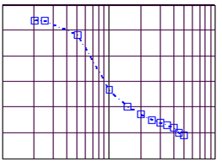
Close-in Ground Losses for Any Small Antenna Close to Ground
3.6 MHz path loss with distance from 2 to 50 metres for a pair of vertical 1m (tuned) loops with centres 1.5 metres above ground:
Top red curve: ground-path loss for dry winter conditions (+2°C) with both loops resonated and matched.
Middle blue curve: ground-path loss for wet winter conditions (+4°C) with both loops resonated and matched.
Bottom black curve: Using one loop open and un-tuned as a ‘field sensor’ and using ‘Faraday’s Law of Induction’ from Maxwell’s Equations. Dry winter conditions as above in (a).
Green Line: Inverse Square Law reference line.
Conclusions from these results:
Close-in ground losses occur in first 10 metres from an antenna close to ground.
Close-in ground losses for dry clay soil = 8dB
Close-in ground losses for wet clay soil = 16dB (but with 1/r surface wave further out?)
Field sensor sensitivity (single turn loop) can be up to 25dB in error if calculated and not calibrated.
The unpredictable and large ground losses under field sensors must also be calibrated out.
Efficiencies of an identical pair of loops is found from the asymptotic path loss as the loops are brought together. This occurs at about 3m spacing for 1m loops as above

Slide 82
Using Heuristics to resolve the ‘Loop Controversy’ once and for all time!
The so-called ‘Loop Controversy’ is now fully explained:
Loop losses concentrated in the capacitor rotor connection is a demonstrably incorrect suggestion.
The critics have mistakenly included ground losses immediately under the antenna and the field sensor in their (poor) loop efficiency estimates by field strength measurement.
This led them to believe that NEC (and any other ‘Method of Moments’ (MoM) simulation programme) correctly predicts loop efficiency. NEC and MoM do not!
The earth is no longer ‘flat’ – at least for most people!
And that’s the end of it! Or is it?

Slide 83
Radiation mechanisms of a small antenna over medium loss ground
Vertical
Processes
Direct radiation of sky-wave from antenna.
Antenna mode losses from strong local coupling to ground
Sky-wave from ground surface wave and currents
Sky-wave to horizontal space-wave layer
Heat losses in antenna.
Antenna to antenna mode coupling
1. Direct radiation of sky-wave from antenna.
4. Sky-wave from ground currents
5. Horizontal space-wave
3. Surface ground wave
6. Antenna to antenna mode coupling
GROUND with radiating ground currents
2. Mode losses from strong local coupling into ground

Slide 84
Reception mechanisms of a small antenna over medium loss ground
Vertical
1. Direct radiation of sky-wave to antenna.
4. Sky-wave to horizontal space-wave layer
Antenna aperture
3. Sky-wave to ground currents
First horizontal space-wave layer
Surface attached ground wave
GROUND with received ground currents
Antenna
Processes
Direct radiation sky-wave of sky-wave to antenna.
Antenna mode losses from strong local coupling to ground
Sky-wave to ground surface wave and currents
Sky-wave to horizontal space-wave layer
Heat losses in antenna.
Antenna mode to antenna coupling
2. Mode losses from strong local coupling into ground
6. Mode to antenna coupling

Slide 85
Effect of antenna height on antenna loss for sky wave
Sky-wave at angle θ1 to horizon
Vertical
Sky-wave at angle θ2 to horizon
Antenna 2
Sky-wave at angle θ3 to horizon
Height limit of vertical loss = ‘Goubau Height’
Vertical loss to antenna 1 height = x dB
GROUND
Antenna 1
For vertical loss to antenna = x dB
At angle θ the sky-wave to antenna loss is increased to x/sin θ
1/sin 30º = 2. Then loss is 2x dB.
1/sin 10º = 5.8. Then loss is 5.8x dB.
Should place antenna higher than the ‘Goubau’ height for low angle sky-wave reception = antenna 2.
Ground sloping away at 1-in-6 (10º), say, is very beneficial

Slide 86
Impact of the ground and environment on antenna ‘effectiveness’
  Absorption height – square root wavelength dependent!
  Tree noise – temperature dependent!

Slide 87
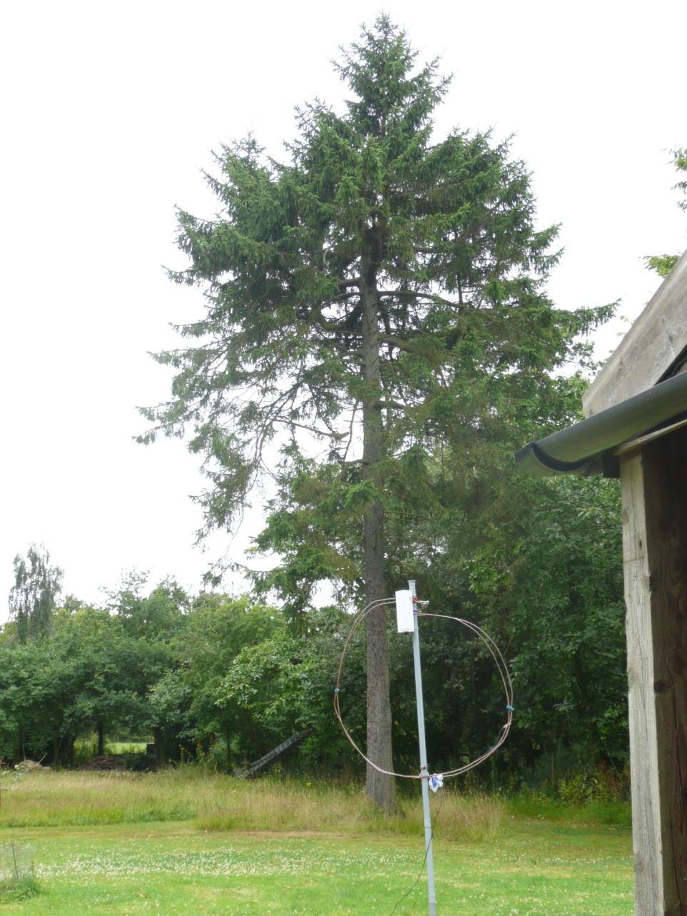
1.5 metre loop 10m away from lossy and noisy fir tree

Slide 88
Progress in (Small) Loop Antennas

Slide 89
The G3LHZ loop-monopole arrangement
Gamma-fed Grounded Monopole-Loop with small ground plane.
The ground-plane can be a ‘bowtie’ about twice or three times the loop size
An attic ground-plane much reduces EMC interference to and from house wiring
The pattern is of a vertical monopole combined with a vertical loop.
It is directional towards the capacitor. Null away from the capacitor
It is like a DF antenna with the ‘sense’ vertical switched on.
Good directionality only occurs with the antenna at the right height above ground; higher for ‘poor’ ground and lower for ‘good’ ground.
The Q is about halved at the highest tuning frequencies, then giving wider bandwidth and higher power operation.

Slide 90
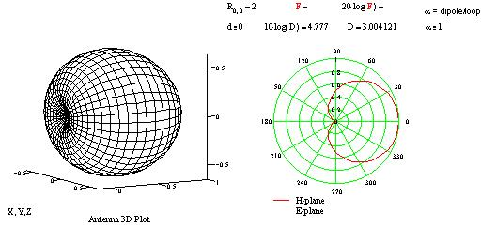
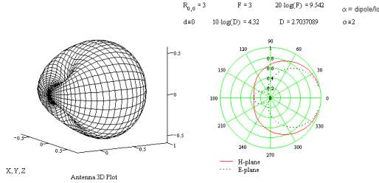
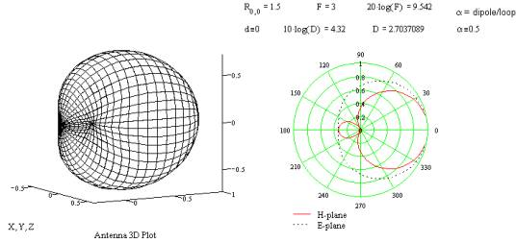
Unidirectional Loop Directivity – a ‘heuristic’ approach
Two loop modes are assumed (electric and magnetic dipole modes).
They combine with an unknown ratio and phase.
to give a unidirectional pattern. We measure a few points o
Directivity in forward (boresight) direction depends on the total shape of the antenna pattern only.
Directivity D = Gain, if antenna is 100% efficient. Gain = Directivity × Efficiency.
Maximum Directivity occurs when the the modes are equal. It is 3 (4.78dBi), relative to an isotropic antenna. There is then a perfect backward null. D = 1.64 for a λ/2 dipole.
Nulls are no longer at right angles to the antenna.

Slide 91
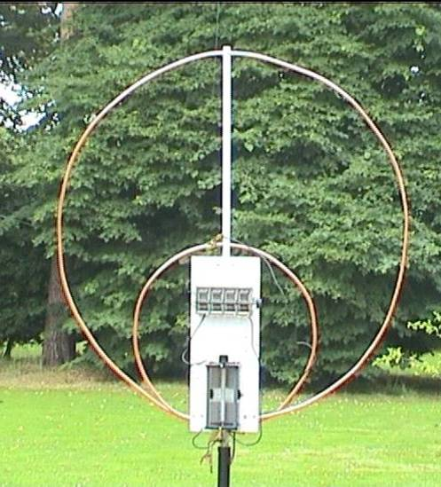
My original 1 metre diameter 1.8 + 3.5 - 30MHz experimental transmitting GP-loop.
Two resonant frequencies, each with about 4:1 tuning range
Twisted gamma match on small loop only
Additional capacitor connected for 160m

Slide 92
G3LHZ Mini-Midi Loop.
Two loops combined: smaller one (mini-loop) is vertical and larger one (midi-loop) is horizontal.
The smaller loop both radiates and acts as a matching unit for the larger loop
It is a two radiation mode antenna
Multi-path interference has been observed between the two modes giving rise to ‘selective fading phase distortion’

Slide 93
Original 2006 (G3LHZ) Mini-Midi Loop.
The ‘mini-loop’ is vertical and the horizontal rectangular ‘midi-loop’ is 20 to 40m (0.25λ to 0.5λ) perimeter at about 2m above ground. (Midi-Loop size is as recommended for the (MFJ) ‘Loop Tuner’.
Bandwidth can be improved to 3% corresponding to a Q of 30 as tapping points are moved towards the capacitor.
Power handling is at least doubled.
The SWR is raised towards 4:1 but any reasonable ATU can handle this without having to adjust the loop match.

Slide 94
2007 Mini-Midi Loop Variants – ‘heuristic discoveries’ not yet fully explained
Small loop orientation matters. If the loops make a right angle, then cross-over (180°) connections give 20dB more sky-wave than same phase (0°) connection, which appears to gives best ground wave in some directions.
Important conclusion is that the two loops radiate about equally. Thus loops and dipoles at same height radiate about equally!
The SWR varies from 1:1 to about 1.5:1 as the small loop orientation is changed by 180°
Power handling is not significantly affected. (Remains about 550 to 750 watts for either orientation).

Slide 95
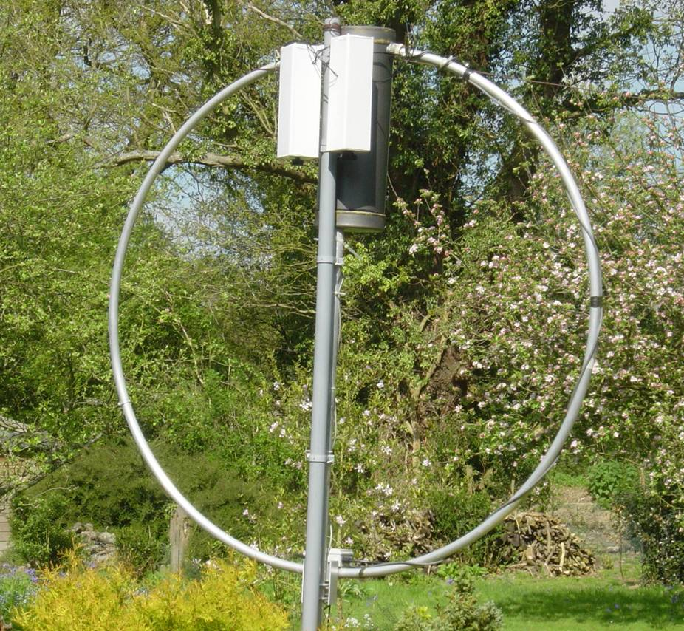
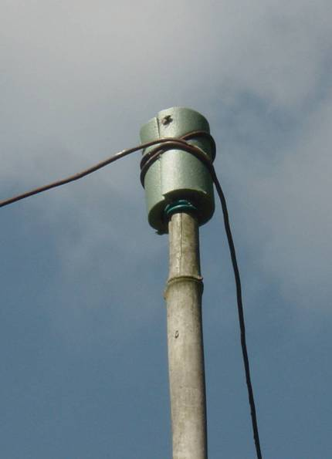
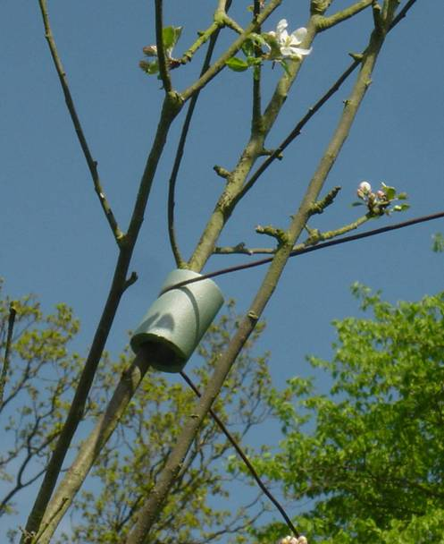
(G3LHZ) Mini-Midi Loop Example.
The ‘mini-loop’ is an AMA5 vertical loop shown with two additional 1440pF Palstar capacitors to tune optionally to 160 m
The horizontal rectangular ‘midi-loop’ is 20 to 40m (0.25λ to 0.5λ) perimeter at about 2m above ground in apple trees. It is attached across the capacitor at top of the mini-loop.
Protection and insulation for the apple tree branches and bamboo support is provided by plastic foam pipe insulation as shown.

Slide 96
2007 Update on (G3LHZ) Mini-Midi Loop.
This was the work-horse antenna for 1.8 to 10MHz.
On 80m it had a combined Q of about 40.
On 160m the Q is about 70. But tuning the loop within this Q bandwidth does affect which loop radiates the most.
The Mini- Midi loop takes at least 500watts over the range with 750 watts possible on 80m. The AMA5 (mini-loop) is rated at 150watts on its own.

Slide 97
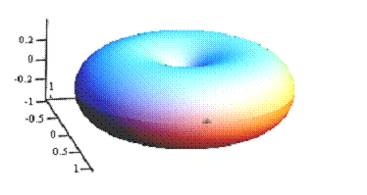
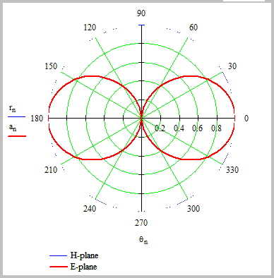
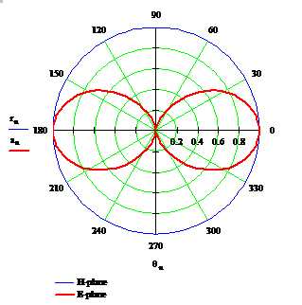
Simulated Heuristic Loop Patterns –
Mini-Loop on left. λ/2 Midi-Loop on right
Mini-Loop Directive Gain = 1.5 = 1.76dBi
Midi-Loop Directive Gain = 1.87 = 2.7dBi

Slide 98
Reference Antenna at G3LHZ = 83m circumference horizontal loop for 1.8 to 60 MHz, now at 15m = 50ft and triangular (not critical)
Optional 1:1 choke balun in feeder is 5×15 cm diameter turns in antenna end of feeder (now removed)
83m circumference loop can be 3 to 6 sides. The shape and area is not critical.
Supports should be 3 to 6 m away from house and trees for minimum domestic noise and tree noise.
Always “the higher the better” , without fail!
To ÁTU
4:1 (balun) transformer is 2×4m 50 ohm coax twisted together in series at loop and in parallel at ATU end

Slide 99
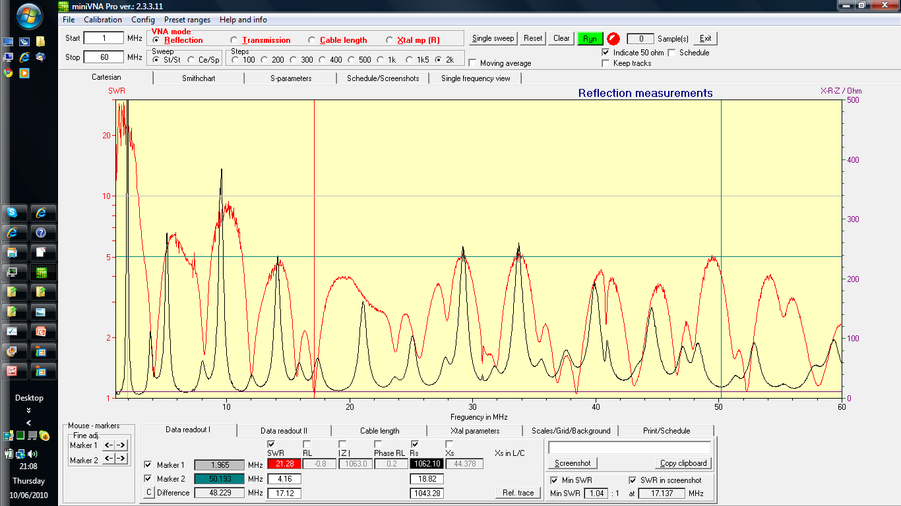
SWR and resistance of 83m Reference Loop from 1 to 60 MHz. Low loss with ATU from 1.8 to >60MHz . SWR is not too high.

Slide 100
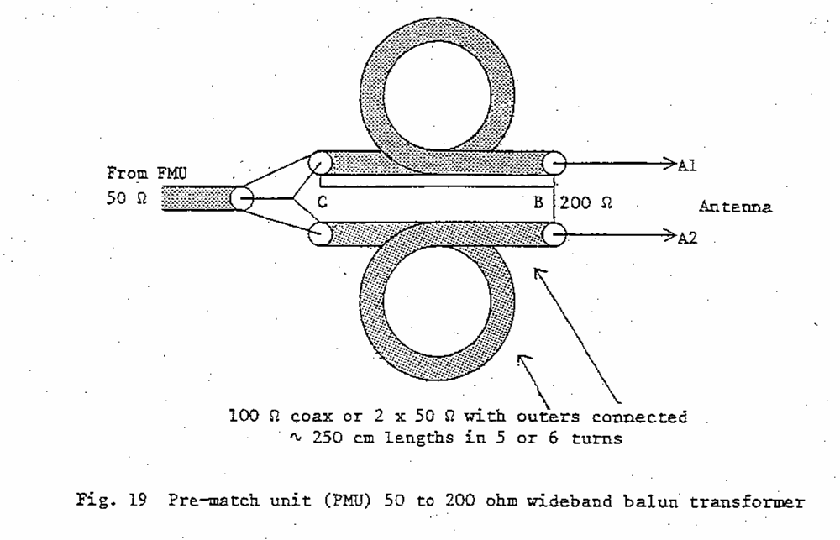
4:1 Wideband Balun Transformer

Slide 101
Antennas Using Metal Roofs and Fences
(in Adelaide, Australia)
In the Adelaide area and in many parts of South and Central Australia corrugated metal roofs and fences are very evident. What effects these have on small antennas was one of the questions after my small antennas talk to AHARS on 4th Feb 2008.
How to achieve good performance on 160m and 80m in a small town lot was another question.
My first reaction was that iron and steel in the antenna environment can be seriously bad news for small antennas.
But this is only true close to a mag-loop where the magnetic fields are strong. It is only the magnetic fields that couple into the high permeability and high loss of iron and steel.

Slide 102
‘Adelaide’ Feb 2008 Update on (G3LHZ) Mini-Midi Loop –1.
Figure1 Connection for vertically-polarised DX operation. Fence is a counterpoise for the roof considered as a patch antenna.

Slide 103
‘Adelaide’ Feb 2008 Update on (G3LHZ) Mini-Midi Loop –2.
Figure 2. Connection for horizontally polarised local NVIS and medium range operation. The fence is connected as the ‘midi’ loop. Poor soil is an advantage – actually a necessity!

Slide 104
Multi-mode and multi-resonant loops

Slide 105
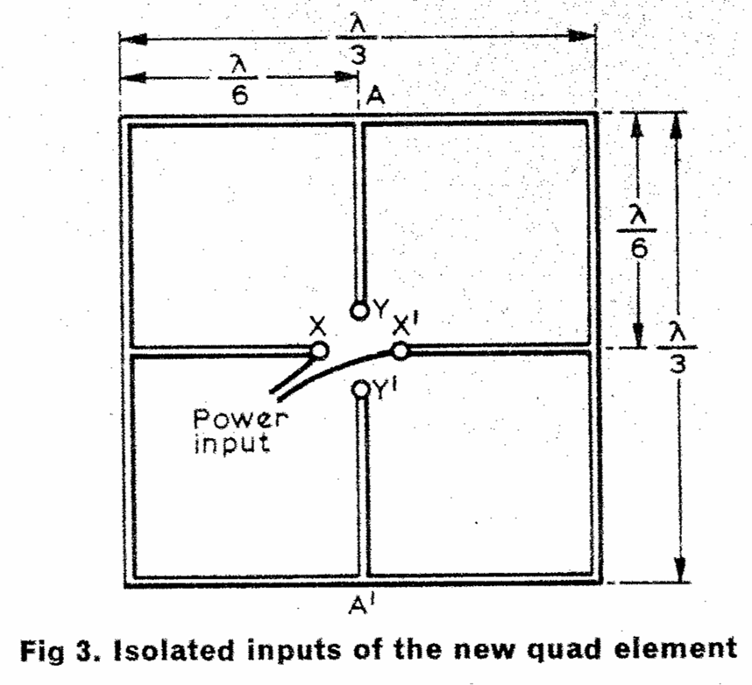
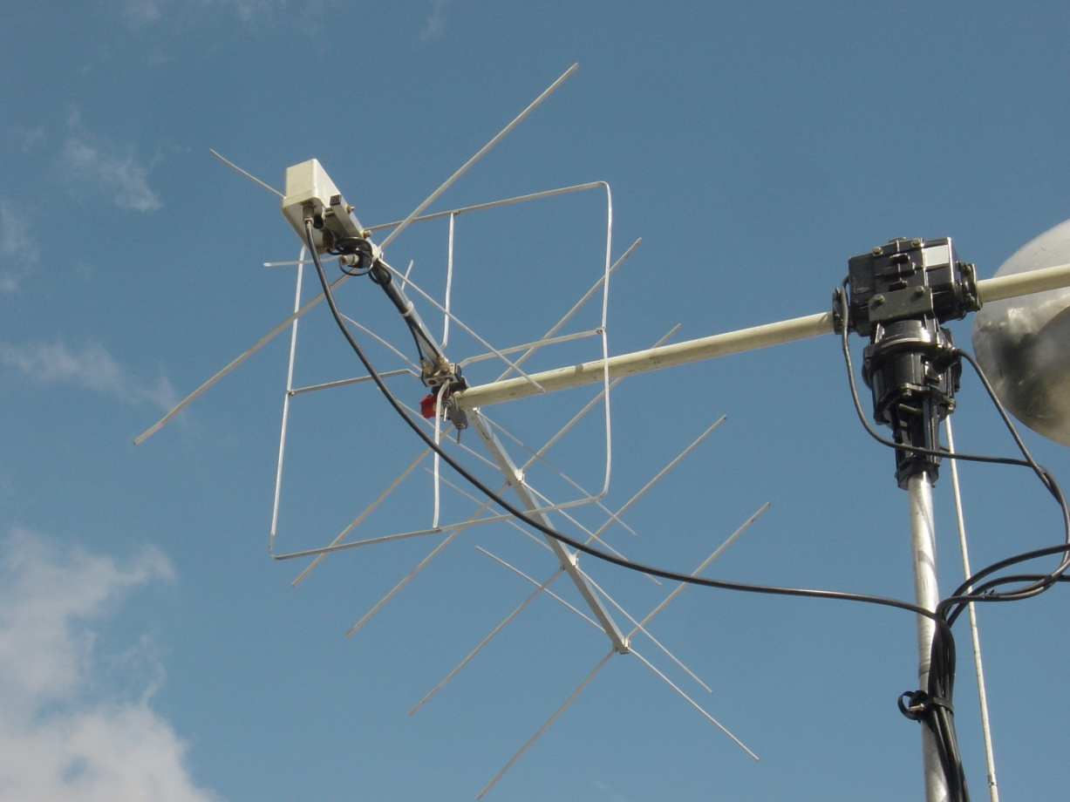
From the Original G3LHZ IP-Quad to Novel Multi-tuned Loops
‘The ip quad – a new versatile quad driven element’
by M. J. Underhill, G3LHZ, Radio Communication, September 1976
WiMo 2m Cross-polarised Antenna as on the GB4FUN Vehicle on 6/5/06 in Belfast. Note the Driven Element!

Slide 106
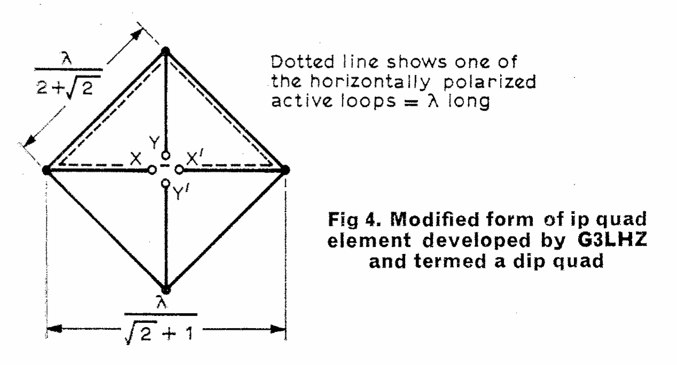
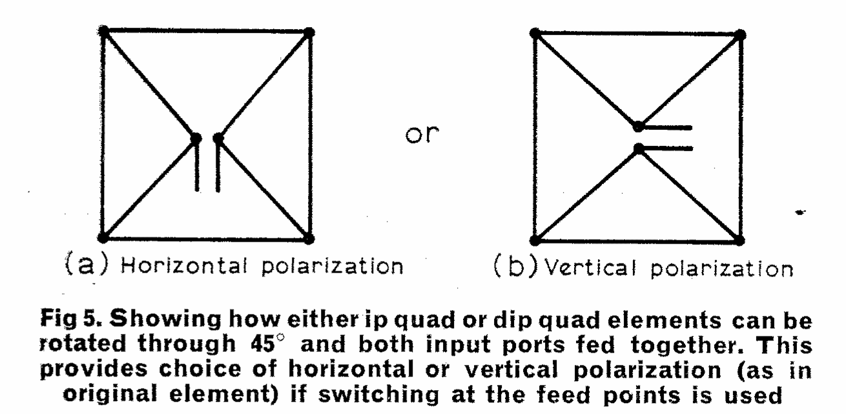
G3LHZ Diagonal IP-Quad
First Reported in Technical Topics November 1976

Slide 107
Centre-Line Tuned Loops
Based on IP quad structure but much ‘smaller’ with respect to a wavelength.
Independent two frequency tuning.
Polarisation can be changed from horizontal to vertical by varying the tuning.
When both ‘ports’ tuned to the same frequency the bandwidth is nearly doubled.
1.7 m diameter loop of 10mm tube handled 550 watts on 160m. >3000pF needed!

Slide 108
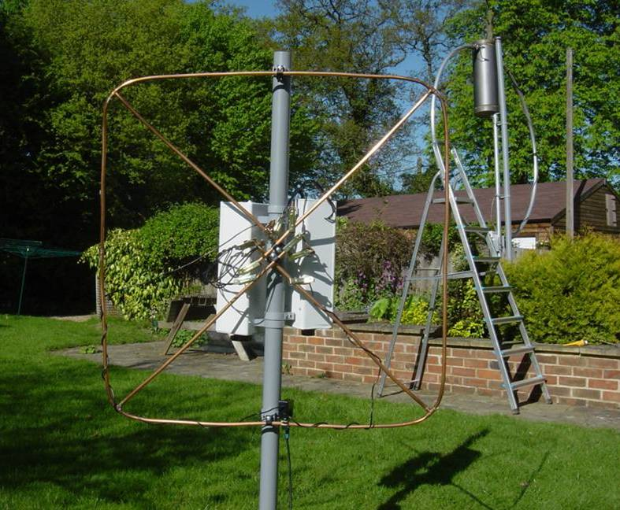
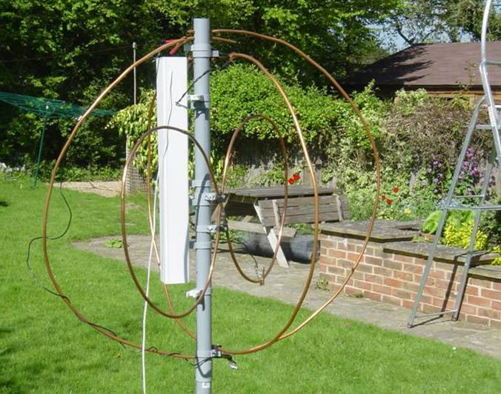
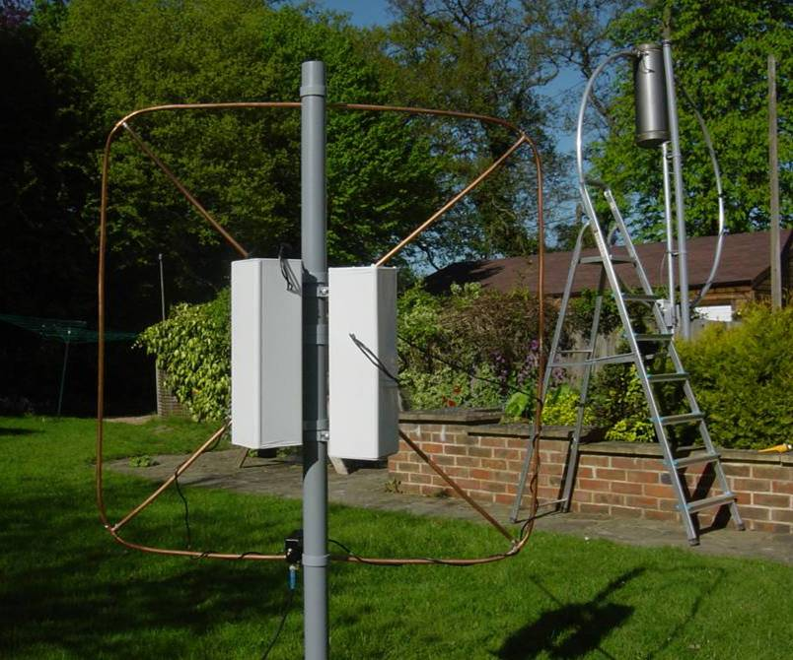
Reasons for Corner Fed Square Loop
Above1m ‘Egg-beater’ for LF, with ‘figure-of-eight’ loop inside for HF is too complicated. However both work well
Parallel loops double the bandwidth and reduce inductance.
Reduced inductance gives greater power handling at the cost of a larger tuning capacitor. Q is also about 1/√2 lower.
Corner fed square loop (at right) does all that combined loops above do.
Connected in parallel improves bandwidth about two times.
Can be simultaneously tuned at up to four frequencies in a 10:1 (or more) range.
All home-made loops shown use 10mm plumbing copper tube
1m square fits in a Laguna with the seats down!

Slide 109
Corner Fed Square Loop

Slide 110
Corner Fed Square Loop – reverse

Slide 111
One Diagonal Square Loop Arrangement
Diagonal Square has same antenna patterns as Square or Circular Loops.
It is a more compact shape, all else being equal.
Easy to construct
With capacitors as shown it is two frequency tuning and ‘variable polarisation’
With one diagonal tuned high and one low, in principle circular polarisation can be achieved at one frequency.

Slide 112
Four-frequency Loop
The four frequencies do interact.
Best if spaced to different bands.
Uses one or more long twisted gamma matches empirically adjusted.

Slide 113
Wider-Band High Power Loops
1m square loop of 10mm copper plumbing tube with about 2000pF capacitance to tune to 80m took 750 watts before flashover. (Used 2 Palstar 1440pF caps.)
Did not self-destruct with this power!
Q is about 140 which is typical for this kind of loop arrangement. (Allows 3 to 4 times the power.)
1.7m diameter loop of 10mm copper plumbing tube with about 3300pF capacitance to tune to 160m took 550 watts with no sign of flashover or overheating.
BW = 9.2 kHz
Q =215 which is typical for this connection. (Allows about double the power)

Slide 114
Novel Small Tuned Antennas derived from the Tuned Loop – How do they work?
Traditional theory says that none of these antennas should work. But they do!
Q and heat measurements once again show efficiencies of 80% to 90% or more.
Can we use heuristics to find out why?
What can we observe from these ‘impossible’ antennas?
The answer is: “Once the RF has escaped the surfaces of the antenna it keeps on going. The antenna pattern is formed further out in the near-field.”

Slide 115
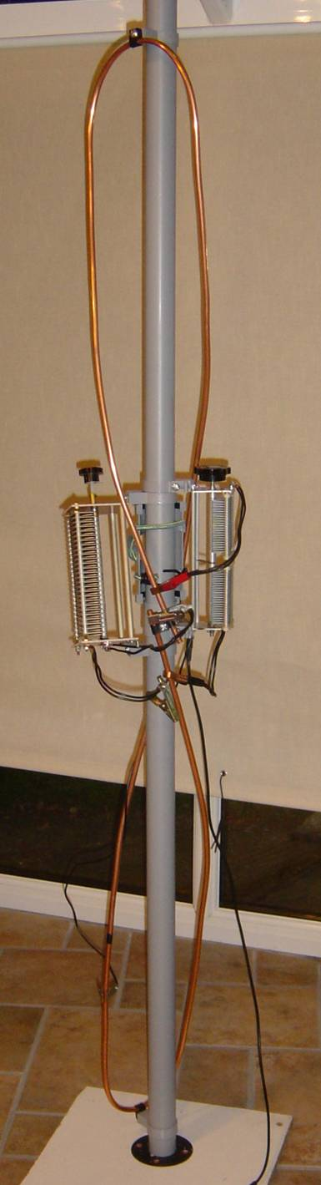
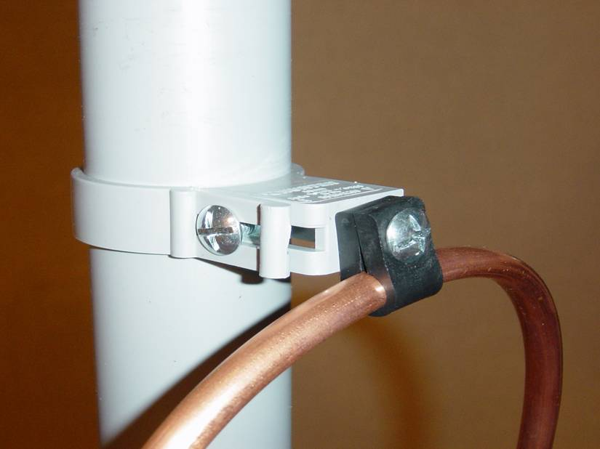
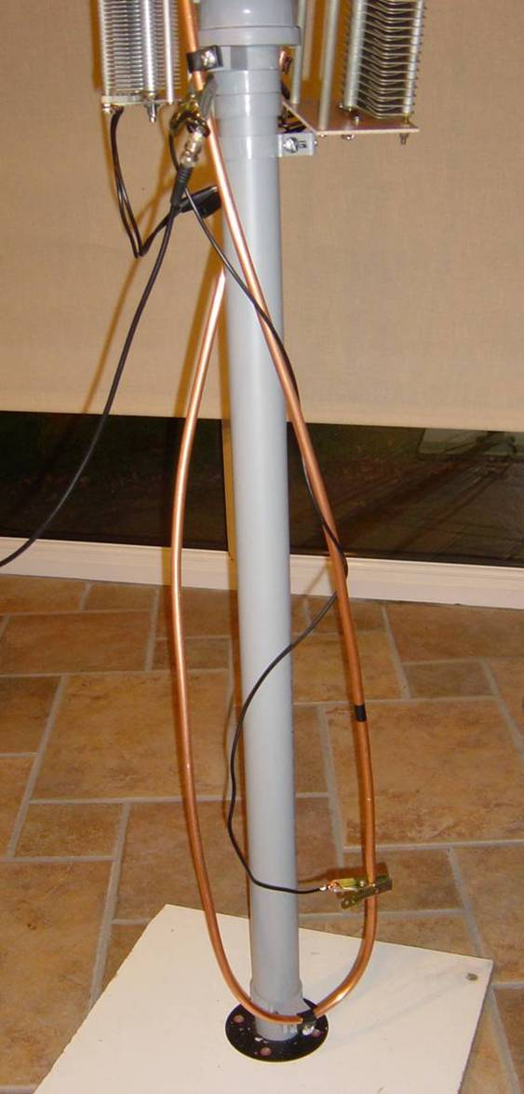

Twisted Tuned Folded Dipole – how can it radiate at all?

Slide 116
Single Capacitor Twisted Folded Dipole-measured in a Conservatory

Slide 117
Twisted Folded Dipole Outcomes
For the single tuned TFD vertical, 500 watts for 1.5 min on 80m gave temperature rise from 16°C to 68°C, a rise of 52°C. The tube length is 4.06m as compared with 1m reference loop of 3.14m. The 1m reference loop gave a rise of 86°C for 150 watts. From this we can estimate the dissipated heat power as 150 ×52×4.06/(86×3.14) = 117 watts
The efficiency is therefore 1- 117/500 = 0.765 or 76.4%
This compares with 76.9% from the Rho-Q method.
Note that the inductance measured at 3.7MHz at 3.09uH is significantly less than a loop of the same length of tube, being 3.84uH.
It means that an opened out loop having higher inductance is more efficient at 86.4% estimated from the Rho-Q method using the same Q value.
Note that a temperature rise of 52°C meant that the loop tuning changed by about 0.2%.
The Q of this antenna increases from about 150 to 350 as frequency rises.
The Double Tuned TTFD version has a Q of down to 150 over most the tuning range

Slide 118
Basic and Double Tuned Folded Dipoles Compared
(can be twisted or straight)
1.Single Tuned - 4m length 10mm tube:
  Tuning range 1.9 to 19MHz
  With some capacitor switching
  Q about 200 to 350 – higher at HF end
  Compromise gamma position if ATU used
2.Double Tuned - 4m length 10mm tube:
  Tuning ranges 1.8 to 11MHz and 5 to 45MHz
  Without capacitor switching
  Q about 150 over both ranges
  Two switched gamma matches recommended
C2
C1
C1
C3
The ‘radiating currents’ cancel out.
Therefore Old EM theory and NEC say that these antennas cannot possibly work!
1. Single Tuned – one main resonance
2. Double Tuned – two main resonances

Slide 119

2m length horizontal double-tuned folded dipole

Slide 120

2m length horizontal double-tuned folded dipole

Slide 121

2m length horizontal double-tuned folded dipole

Slide 122

miniVNA demo, 2×70cm hairpins (one double tuned on right), 70cm tuned folded dipole, and 35cm 1-150MHz double tuned loop

Slide 123

Double Tuned 70cm Hairpin SWR Plot on MiniVNA

Slide 124
The New Radiation/Reception Theory – derived heuristically from observations of the above ‘impossible’ antennas
The receiving capture area of a wire (dipole) antenna is many times greater than the physical area of the antenna. Why?
There must be a ‘focussing lens’ surrounding the antenna. This must exist irrespective of the power to or from the antenna
We find: once the RF escapes a conductor diameter or so it just keeps on going.
The ‘real currents’ do not cancel. How then do the antenna patterns form?
From heuristics we find that cancelling real currents generate large ‘magnetic displacement currents’ in the ‘cancellation space’ in the antenna near field.
It is the displacement currents that radiate, receive and store the antenna energy.
Displacement currents form in regions of ‘high energy capacity’= novel concept!
The coiled hairpin antenna shape is such that the magnetic displacement currents also cancel. Then the cancelling ‘magnetic displacement currents’ create radiating ‘electric displacement currents’. And so on ad infinitum!
We find in general that the original polarisation of the waves is preserved.
Received signals generate exactly the same displacement current distributions
The stored energy divided by the transmitted or received energy per cycle is the measured antenna Q. A local Q at any point in space can be similarly defined.
In essence that’s all there is to the radiation theory of antennas!
It’s simple really!

Slide 125


2.2 m high ‘Double Dustbin Antenna’ with internal tuned folded dipole of 5×2m = 10m total length.
Does it work?
Yes it does! It has been tested on 3722kHz
How does it work?
What modes are there at different frequencies?
Is it a bit like a CFA? Does it have the same radiation modes?
Q is measured at 20 to 140
Efficiency >80 or 90%
More measurements and optimisation to be done:
See how Q varies with ground conditions (as found by loop ground sensor)?

Slide 126

Tuned Hairpin Antenna
Twisted loop-gamma feed →
  2m height hairpin
  >200watts 2 to 10MHz
  Can be double tuned to go to 30MHz
  Efficiency >80 to >90%
  How can it possibly radiate? – The currents well and truly cancel!

Slide 127

Pair of Tuned Hairpin Antennas
Antenna patterns under investigation:
  Depends on type and orientation of field sensor!
  An identical pair of antennas is the only safe way to sort this out!
  This is the heuristic approach:
  Do the measurements!
First results:
  There are two dipole patterns
  The horizontally polarised pattern is max at ‘broadside’
  The vertically polarised pattern is max at ‘end-on’. It is a magnetic dipole pattern like a loop. It is 3dB down on the other mode

Slide 128

Coupling between two 2m length vertical tuned hairpins spaced 1.5 metres apart (using MiniVNA)
Also note that there are deep nulls if either hairpin is rotated by 90°

Slide 129

Coupling between two 2m length vertical tuned hairpins spaced 4.2 metres apart (using MiniVNA)
Also note that there are deep nulls if either hairpin is rotated by 90°

Slide 130

Coupling between two 2m length vertical tuned hairpins spaced 1.5 and 4.2 metres apart (using MiniVNA)
Also note that there are deep nulls if either hairpin is rotated by 90°
But how can there be two independent patterns for each hairpin?

Slide 131

Coiled Tuned Hairpin
80cm diameter coiled
>200watts 2 to 10MHz
  Can be double tuned to go to 30MHz
What is the pattern? – under investigation –heuristically!

Slide 132

Coiled Double-Tuned Hairpin
80cm diameter when coiled
>200watts 1.8 to 30MHz double tuned
May need switched twisted gamma matches
What is the pattern? – under investigation –heuristically!

Slide 133

Heuristically Derived Antenna Pattern of Coiled Hairpin

Slide 134


Figure 1: Pair of Candidate ‘Tuned Coiled Hairpins’ in front of UR Labs at one end of UR Open Range for Small Antenna Measurement. (Antennas 5m apart)

Slide 135
Figure 3: Original Open Range Arrangement of Equipment.

Slide 136

Figure 2: Underhill Research Open Range for Small Antenna Measurement. (Illustrating Rotatable 6.1m End-fed Horizontal Wire (inside plastic pipe) at 16m Distance with UR 35cm Receiving Loop in Foreground.)

Slide 137


Doubly Resonant 35 cm Receiving Loop 1.5 to 150 MHz.
Example of long twisted gamma match coupling to two loops
Added switched capacity to tune down to 1.5MHz

Slide 138

Experimental Antennas (Explained by Goubau ?)

Slide 139


Wide-band Un-tuned Receiving Loops (Field Sensors)
35cm and 50cm diameter examples for 100kHz to >100MHz
Multi-turn for LF performance, switched single turn for HF
But what field is sensed, H or B? Suggestions are:
At low frequencies H field is sensed (by ‘Reciprocal Biot-Savart law’)?
At high frequencies B field is sensed (by induction)?

Slide 140


Broadband and Wide-band Tuning Multi-turn Transmitting Loop
Rounded square loop 11 metre perimeter in plastic water pipe
Four turns of single core 2.5mm PVC covered domestic wire
4:1 impedance balun
Best when vertical – 12db better?
SWR<6:1 from 5 to 30MHz with no tuning
Q = 30 to 40 from 1.8 to 30MHz when tuned
Takes 800w but original T-match (C1, L, C2) ATU got hot for 80m and top band. So balun removed.

Slide 141

SWR of Broadband and Wide-band Tuning Multi-turn Transmitting Loop – using miniVNA

Slide 142

Smith Plot of Broadband and Wide-band Tuning Multi-turn Transmitting Loop – using miniVNA

Slide 143

Broadband and Wide-band Tuning Multi-turn Transmitting Loop with additional horizontal midi loop of 50m perimeter on or just above ground
SWR<6:1 from 5 to 30MHz with no tuning but needs to be re-measured
Q = 20 to 30 from 1.8 to 30MHz when tuned
Takes 800w easily but original T-match (C1, L, C2) modified to be L-match on 80m
Cannot use L-match on top band. Need more capacitance. So power limit is reduced – to 500 watts. But antenna Q is lower at 20 on top band.

Slide 144

Broadband and Wide-band Tuning Multi-turn Transmitting Loop with additional horizontal midi loop of 50m perimeter on or just above ground
SWR<6:1 from 5 to 30MHz with no tuning but needs to be re-measured
Q = 20 to 30 from 1.8 to 30MHz when tuned
Takes 800w easily but original T-match (C1, L, C2) modified to be L-match on 80m
Cannot use L-match on top band. Need more capacitance. So power limit is reduced – to 500 watts. But antenna Q is lower at 20 on top band.

Slide 145
Coupled Mode Loops
They are in the class of Coupled Mode Antennas that includes: CFA, CFL, EH and other controversial antennas.
The controversy is whether the ‘Chu-Wheeler small antenna Q criterion’ is obeyed or not.

Slide 146
Coupled tuned circuit model of Coupled Mode (loop) Antenna

Slide 147
Tuneable Coupled Mode Loop with Ground-Plane or Vertical Counterpoise
Under development
2 magnetic modes below10MHz
Additional electric mode above 10MHz
5:1 SWR above 10MHz – relies on ATU
~1.5m diameter
Target Q <140
3 to 60MHz
1.8MHz with side-loading two turns?
Counterpoise is essential.
Counterpoise can be tower, or elevated ground plane if in attic
Rotatable as it is directional below ~10MHz
To ÁTU

Slide 148

Two-turn 80cm tuneable Coupled Mode Loop

Slide 149

Resonances: 3.78MHz (Q = 200) and 7.2MHz (Q = 133)

Slide 150

AMA5 loop with 2 turns end connected side loading gives Q about 50 to 200 depending on the surroundings

Slide 151

AMA5 loop with 2 turns end connected side loading
Wet condx: at 3.5MHz Q = 200; at 7MHz Q = 140

Slide 152
Small Tuned Antenna and Loop Construction
10mm diameter ‘mini-bore’ ‘semi-flexible’ copper tubing is recommended for loop and other small antenna conductors. It is available from ‘Plumb Centre’ in 10m lengths at about £20.
It does not have to be cleaned. A tarnished copper loop works just as well as a cleaned and polished one. Paints are probably best avoided.
For the loop support 50mm grey plastic down-pipe is recommended. (You could fix a loop to an existing plastic drain-pipe!). For extra strength a length of (square) timber can be inserted.
The 50mm pipe support clips are ideal for supporting the loop on the pipe and for attaching the (motor tuned) tuning capacitors.
To attach the loop to the support clips, ‘No. 4’ black plastic cable cleats are ideal. Try TLC or similar electrical suppliers. A bag of 100 cleats should be less than £10.
The clips may be attached using the same type of ‘roofing bolts’ as used for the down pipe clips. Longer bolts are needed for attaching two cleats to one down-pipe support clip.
Water-proof white plastic boxes for tuning capacitors may be cut to length from square electrical trunking. ‘Stop-ends’ complete the boxes. The useful standard sizes are 75×75mm or 100×100mm, available from TLC or similar electrical suppliers . Bath sealant can complete the water-proofing if felt necessary. Otherwise white insulating tape may be used.
For remote tuning, motors with gearboxes and 6mm shafts are available from MFA/Como Drill. Remember that higher ratio gear boxes in general have more backlash. Lower ratio ones introduce more motor control ‘overshoot’.

Slide 153
Latest Conclusions
Old Theory and NEC say that Small Tuned Antennas cannot possibly work! Heuristics (measurements) show they do! EM theory and NEC need upgrades!
Unexpected ground losses under any small antenna explain the misunderstanding.
Surely Old Theory (Chu-Wheeler) and NEC must now be upgraded to comply?
The ‘loop controversy’ is ‘dead’– it must be buried. (For CFA also?)
Any small antenna made of 10mm copper tube of any length will be 80% to 90% efficient. Much larger than this is a waste of copper!
Splitting a loop into 2 or 4 segments reduces Q by √2 or 2 respectively and increases power handling by 2 or 4 times. Small antenna powers of 0.5 to 1kW are now practical without vacuum capacitors.
All the materials for efficient small antennas are available from most counter-sales building suppliers
New Heuristic EM theory explains simply why antennas transmit and receive.
New and ‘novel’ antenna types can now be invented, e.g. The Coupled Mode Loop etc
Local ground losses can be found with small 50cm loops
Electromagnetics is still in its infancy. There is much to be discovered.

